Slide 1
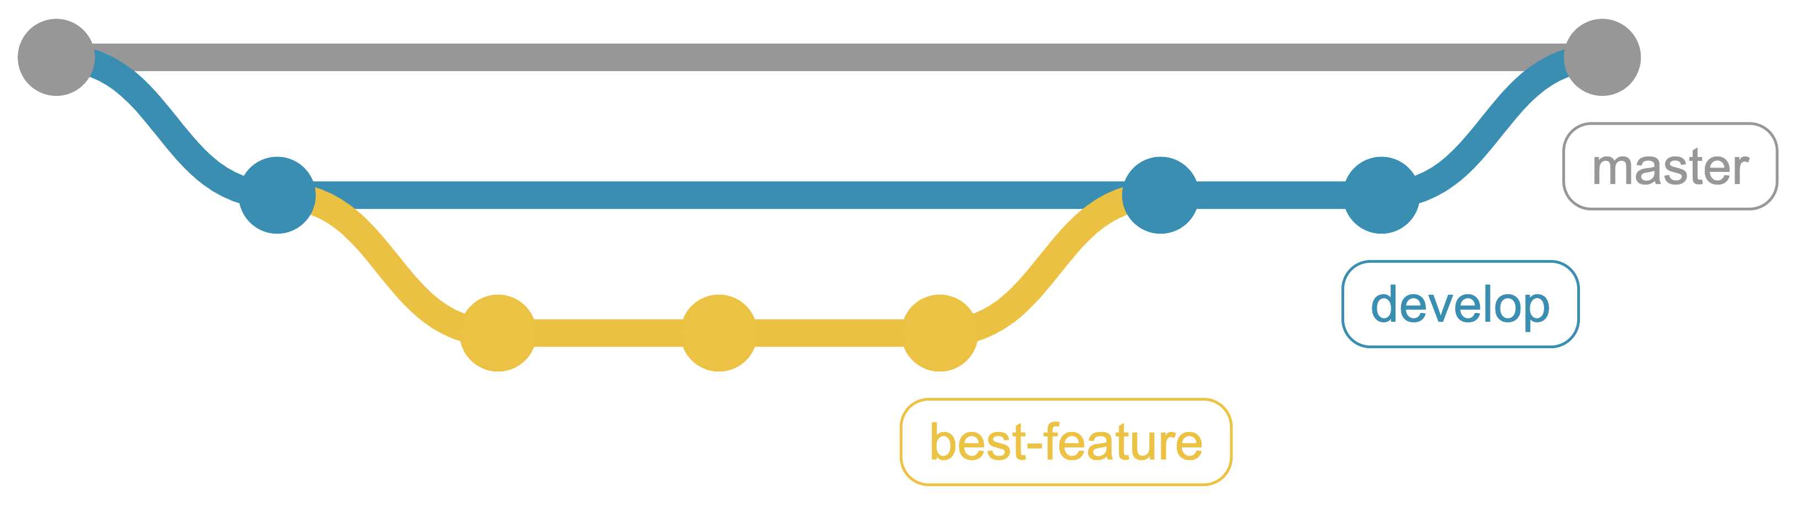
From Punch Cards to Git
A Brief History of Version Control
https://github.com/CuriousCurmudgeon/history_of_vcs
Notes:
Good morning. How is everybody doing? I would like to thank you for waking up early after the waterpark party last night and joining me this morning on the last day of CodeMash.

Slide 2

Brian Meeker
@CuriousCurmudge
Notes:
My name is Brian Meeker. I'm a software developer for InfernoRed Technology. I work as a consultant, mostly in .NET and JS/Typescript, but also a bunch of other things. My official title is Engineering Wizard, but I'm a jack of all trades, master of none kind of guy.

Slide 3

Look for the dragon right outside of Salon A.
Notes:
Stop by the InfernoRed booth if you want to chat about this talk or any other cool stuff you've seen at CodeMash this week.

Slide 4
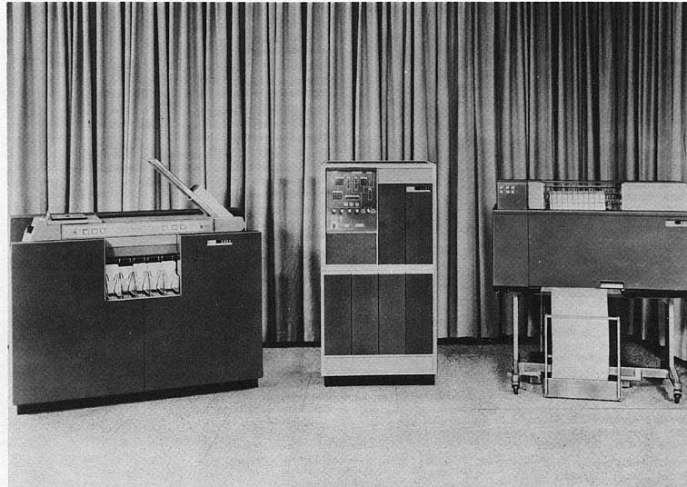
Wikimedia Commons / Gobierno de los Estados Unidos
Notes:
So, you're here for a history talk. What makes me qualified to give a history talk? This is me putting my imaginary history minor to use. You see, I took all the courses to get a history minor, but never actually talked to anybody in the history department about it, so... no minor for me. But I put in all the work, and I think that's the important part. I'm pretty sure that avoiding the paperwork and the human interaction required to complete a task is the most stereotypical software developer behavior you can imagine.
And for the curious, from left to right those are a
IBM 1402 Card Read Punch, Model 1 - $24,800
IBM 1401 Processing Unit, Model A-1 - $70,500
IBM 1403 Printer, Model 1 - $30,300
Total Price $125,600 (in 1961)
Apparently, the Computer History Museum in Mountain View, CA has two working 1401’s.
The other motivation for this talk came from CodeMash last year. I want to thank Jenny Manning for doing her talk at last year's CodeMash - Mommy, where do new programming languages come from? last year. Her talk was the inspiration for me submitting this talk and speaking here this year.

Slide 5
What is version control?
…the management of changes to documents, computer programs, large web sites, and other collections of information.
- https://en.wikipedia.org/wiki/Version_control
Notes:
So, what is version control?
I am not above stooping to Wikipedia for definitions. This one is pretty straightforward and probably matches your intuition about what version control is.

Slide 6
What is version control?
…a system that records changes to a file or set of files over time so that you can recall specific versions later.
- https://git-scm.com/book/en/v2/Getting-Started-About-Version-Control
Notes:
But I like this version from the official Git book more. I like that it calls out recalling specific versions later.
You'll notice this definition doesn’t lay out any specific requirements about what features a version control system needs to have. You just need to record changes so you can get back to a specific version if needed. That's it.

Slide 7
Terminology
VCS = Version Control Software/Version Control System
SCM = Source Control Management/Software Configuration Management
Revision Control
Notes:
There are also a couple of different terms for version control.
VCS = Version Control Software/Version Control System
SCM = Source Control Management/Software Configuration Management
Revision Control
I’m going to try and be consistent here and use the term “version control system”.

Slide 8
Out of Scope
Hosting services (SourceForge, GitHub, Bitbucket, etc.)
Integrated version control
Wikis
Most commercial systems
Notes:
These topics are interesting, but out of scope.
Repository hosting services like Sourceforge, GitHub, and BitBucket.
Integrated version control, like you see in modern word processors, spreadsheets, or content management systems.
Wikis
Most commercial systems, with one important exception.

Slide 9
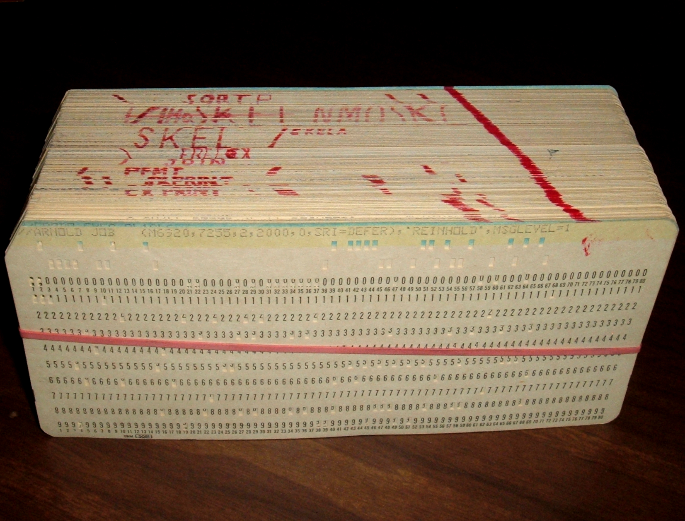
Punch Cards
Wikimedia Commons / Arnold Reinhold
Notes:
Can anybody tell me what this is?
Has anybody here actually used these before? Looking around the room, I feel pretty confident that the answer for just about everybody is no. If anybody has, can you tell me when you used them and where?
Fun fact, the title of this talk has ”punchcards” as one word. This may surprise you given my quickly greying status, but I’m not old enough to have ever used punch cards. From what I was able to find “punchcards” as one word is acceptable, but two words is more common. And “punched cards” is also a thing and arguably the correct way to say it if your card has already been punched.
So, imagine that you're working on your new assignment. You need to get your punch cards ready. How do you think you would organize these? Do you think it's possible to have any concept of version control?
The answer to the second question is, not really. Given two decks of punch cards, there isn't an easy way to diff them. There were machines to duplicate a punch card deck, but not anything that would compare them as far as I know.
So, I think the best we can do is talk about how a programmer would maintain his punch card deck with the understanding that it is not version control.

Slide 10
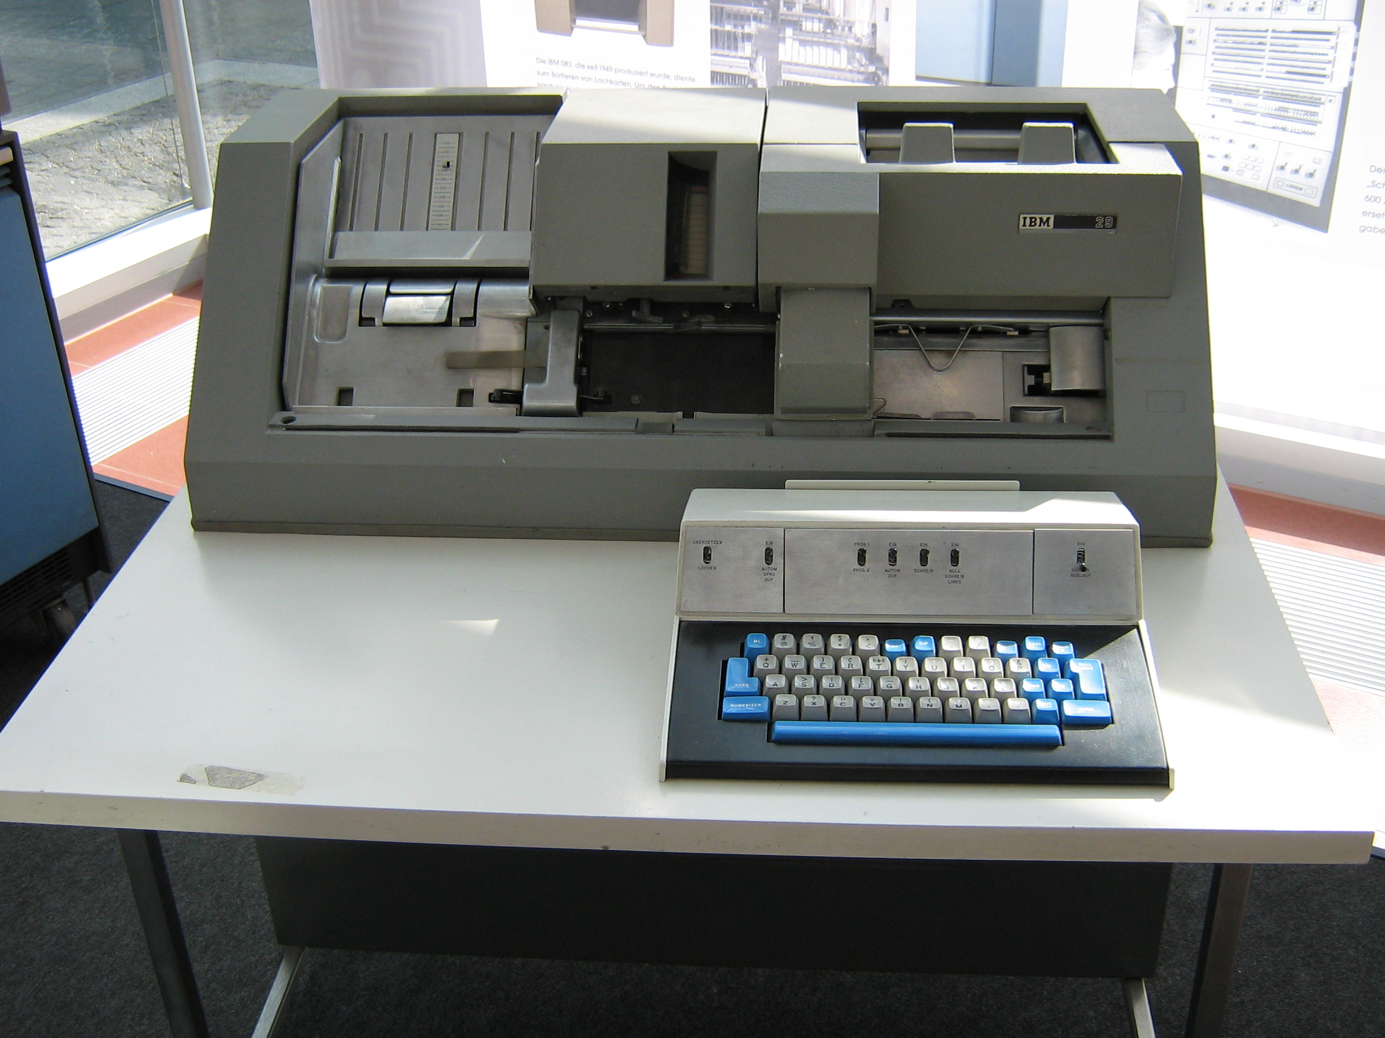
Keypunch Machine
Wikimedia Commons / waelder
Notes:
Does anybody know what this is? This is a keypunch machine. After writing your program on coding sheets, you would take your sheets over to a keypunch operator, usually a woman because, you know, patriarchy. The keypunch operator would use this machine to turn your written source code into something that could be fed into a computer.
This model specifically is the IBM 029 Key Punch. It was introduced in 1964 at the same time as the IBM 360.

Slide 11
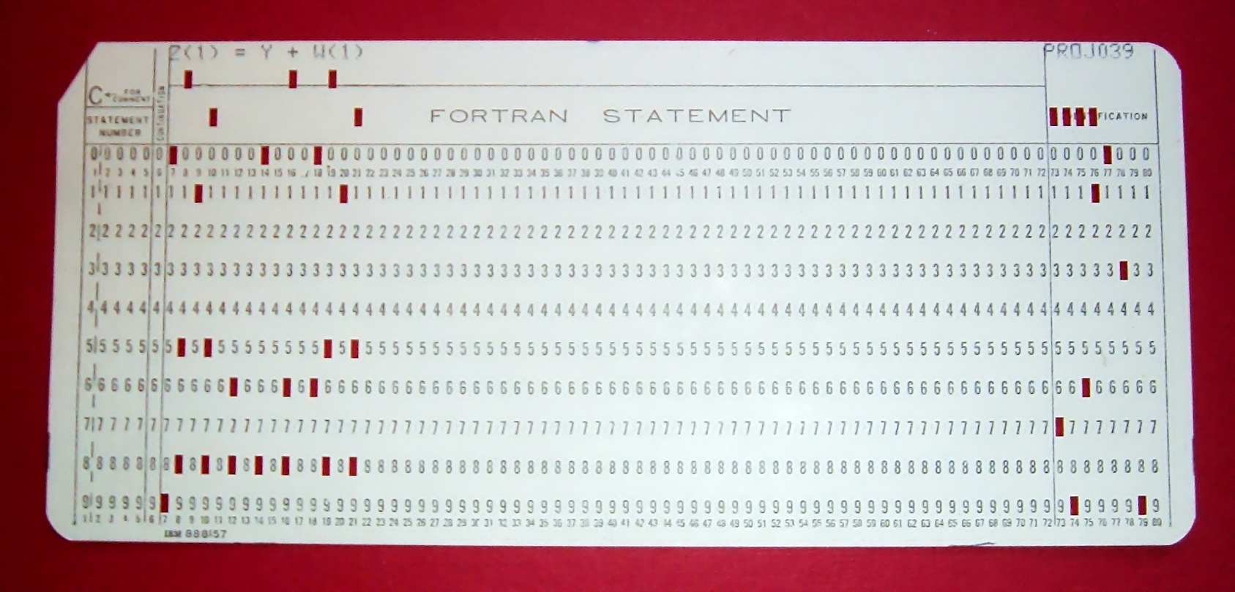
Running Your Program
Wikimedia Commons / Arnold Reinhold
Notes:
So, now you have punch cards for your program, but could a computer directly run these punch cards? Look closely at the top of the card here. What do you see? Source code. The punch cards from the keypunch machine are just your source code in a format that can be fed into the computer. And what do we do with source code before the machine actually runs it? We compile. Some languages today still make this an explicit step. Some do it implicitly, but the code is always compiled before the machine can run it.

Slide 12
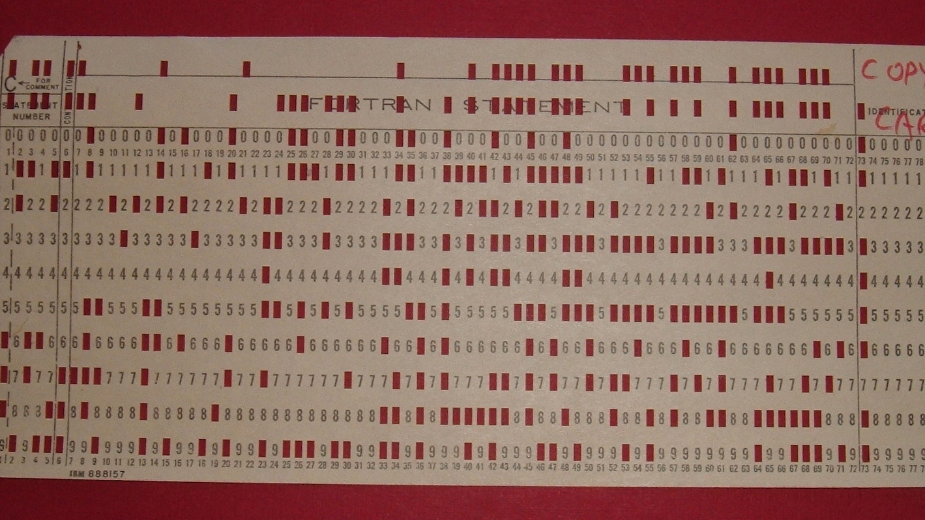
Compiled Punch Card
Wikimedia Commons / Arnold Reinhold
Notes:
So you would take your punch card deck to the computer operator and they would attempt to compile it for you.
This particular compiled card contains a self-loading IBM 1130 program that would copy the deck of cards placed after it in the input hopper.
If you were incredibly lucky/good/fortunate to have a simple task, then your program would compile the first time. Let's assume it did compile correctly though. Next, the computer operator would load your deck of compiled punch cards into the machine to execute the program. You would then get your original deck, compiled deck, and printed output back.
Now, chances are good that your program didn't work correctly the first time. It almost never does and you have to remember that these programmers had no real time feedback. There was no test suite running constantly. No debugger. No IDE. Nothing. So, now we can finally get to the real problem. How did a programmer manage changes to their punch card deck?

Slide 13
Wikimedia Commons / Arnold Reinhold
Notes:
First, your helpful keypunch operator would often draw a diagonal line like this across the top of your cards. Now, if you dropped your deck, you could put it back in order by recreating the line. Not the most reassuring of systems, but it was a nice start for a new deck.
There was also a machine to quickly create a copy of your deck, a punched card duplicator.
But what would happen when you start making edits to your deck. The keypunch operator shouldn't have to type up a new copy of your deck every time you make a change. As a programmer, you should be able to type up a new card as needed to insert into your deck. However, your line won't be very useful in that case. It will quickly become a jagged mess.

Slide 14
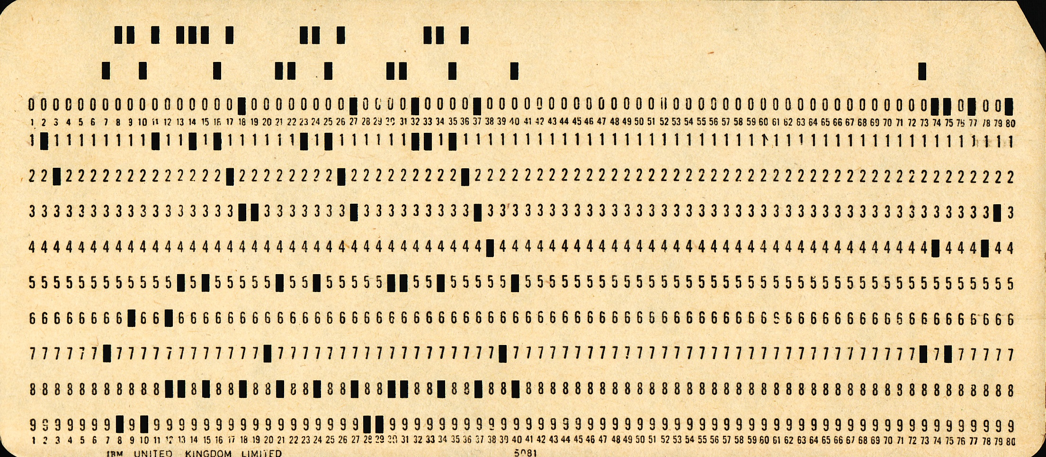
Sequence Numbers
PUX 430
Wikimedia Commons / Pete Birkinshaw
Notes:
Does anybody know how many columns there are on a standard punch card? 80. If you look closely at this card, you will see the columns labeled at the top and bottom all the way to 80. However, it was common practice for compilers to only look at the first 72 columns on the card. So, that gives us 8 unused columns and those columns are the key to ordering the deck.
I did not spend the time to get good at reading these cards, but apparently this is another Fortran card with the sequence number “PUX 430”

Slide 15
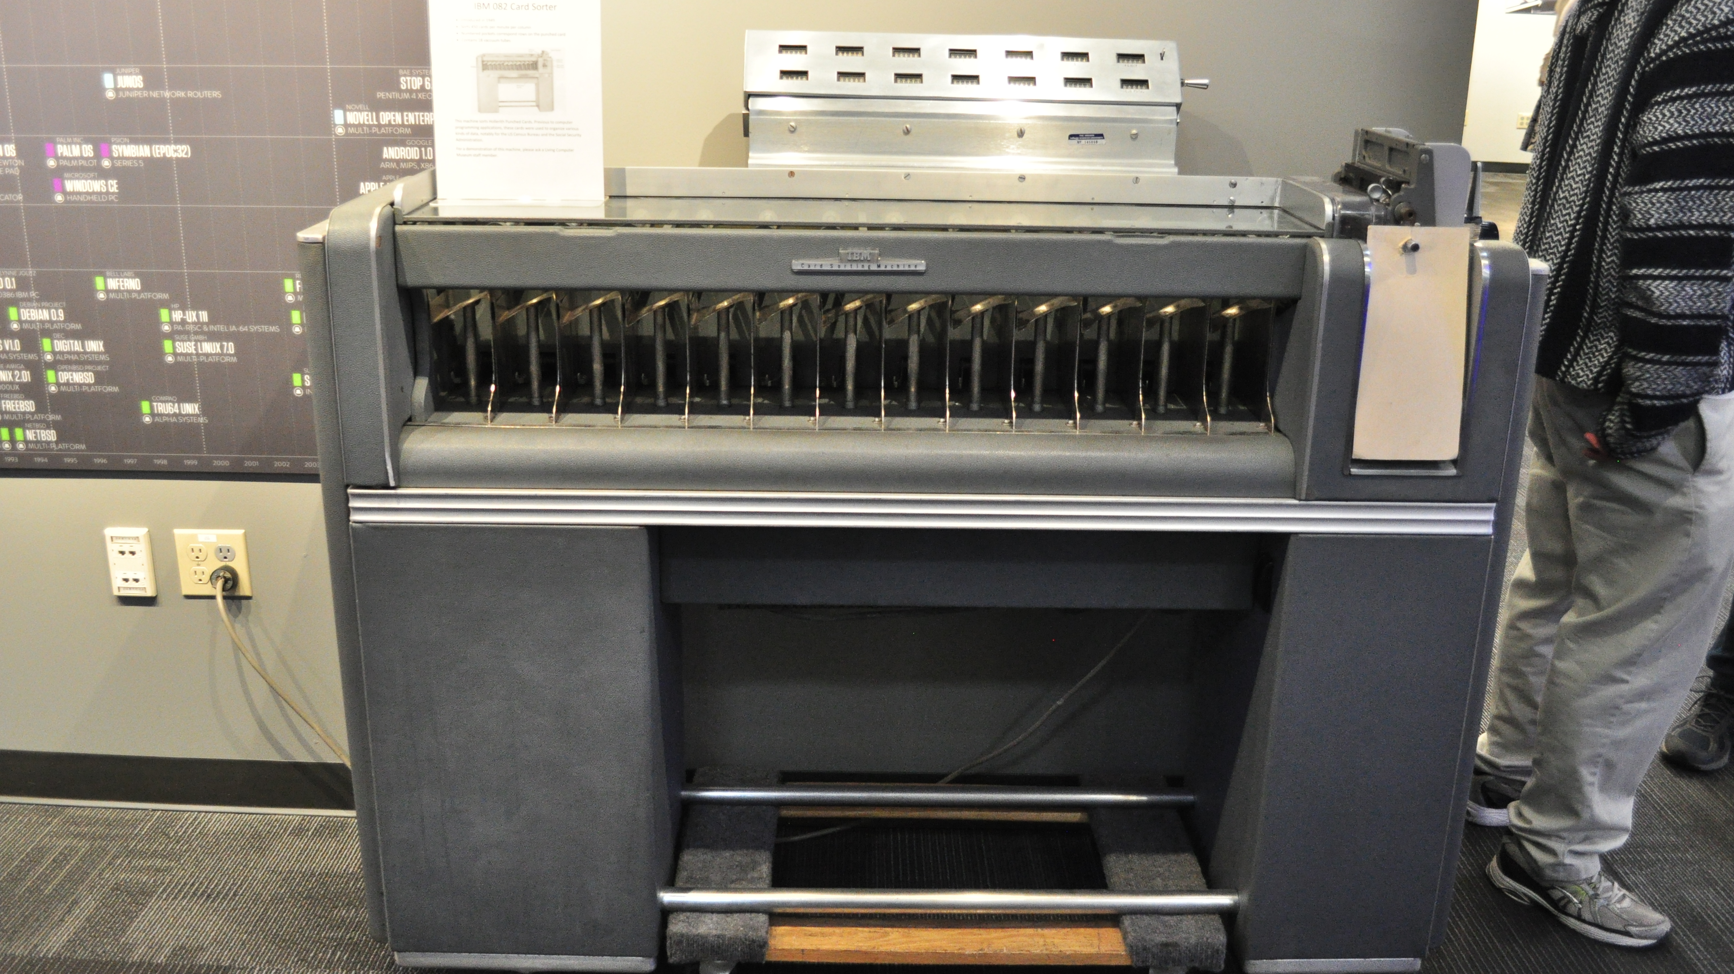
Punch Card Sorter
Wikimedia Commons / Joe Mabel
Notes:
This is an IBM 082 card sorter at the Living Computer Museum in Seattle. This model came out in 1949 and could sort 650 cards per minute. You could use a machine like this to sort a deck by sequence number.
That kinds of just shifts the problem around though. What if we have our sorted deck and we want to insert a new card in the middle of our program. For example, we want to insert a new card 32 and shift the rest of the deck back. How do we easily renumber our cards? Easy, you write a program for it. The compiled card we saw earlier was something like that. So you feed your deck into the machine in the new order. The machine ignores the existing sequence numbers and copies your deck with new sequence numbers.
There are still a lot of limitations here. Getting new sequence numbers is automated, but if you put a card in the wrong spot in the deck you won't have any record of that. Depending on how long you needed to wait for computer time, you might notice before you compile. If you don’t catch the error then you'll have to compile and, if it compiles successfully, execute your program to recognize your mistake.
There's also no trail of any changes. Collaborating with another programmer on a problem is very difficult. You would have to very, very carefully negotiate who is working on what. And even when working by yourself, you can't look at your history and figure out where you introduced a bug.

Slide 16

Wikimedia Commons / Marcin Wichary
Notes:
For awhile while putting together this talk, I thought that sequence numbers and punch card sorters were the end of the line for the punch card era. And that was true for the vast majority of programmers of the day. However…

Slide 17
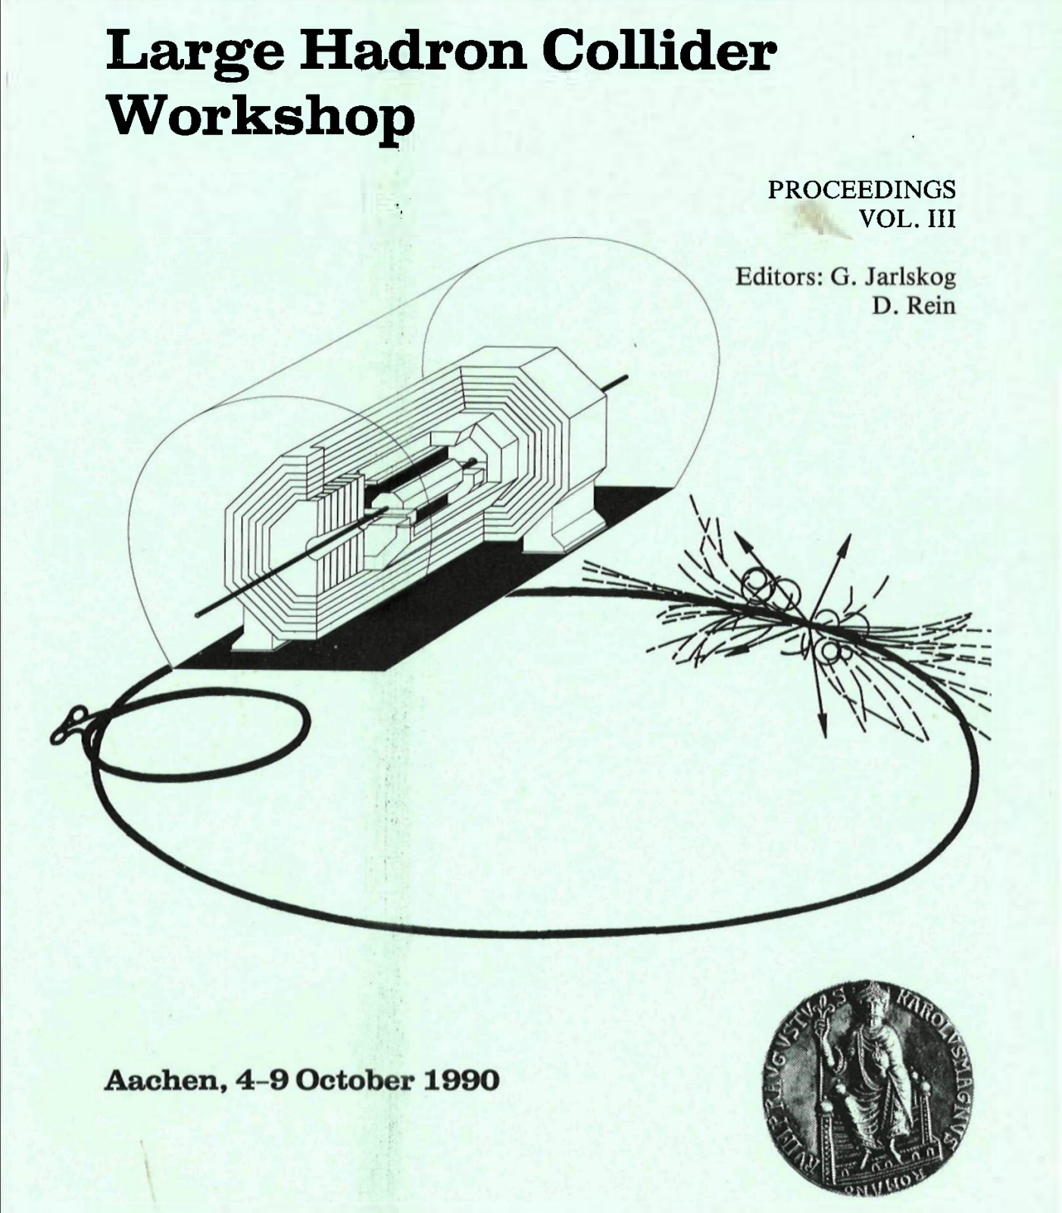
Progress is not evenly distributed
International Atomic Energy Agency
Notes:
…progress is not evenly distributed. I stumbled upon the proceedings from a Large Hadron Collider workshop in October 1990. If you were a researcher at CERN in 1965 there was something else you could have used. And if you were still a CERN researching in 1990, you might still be using the same system.

Slide 18
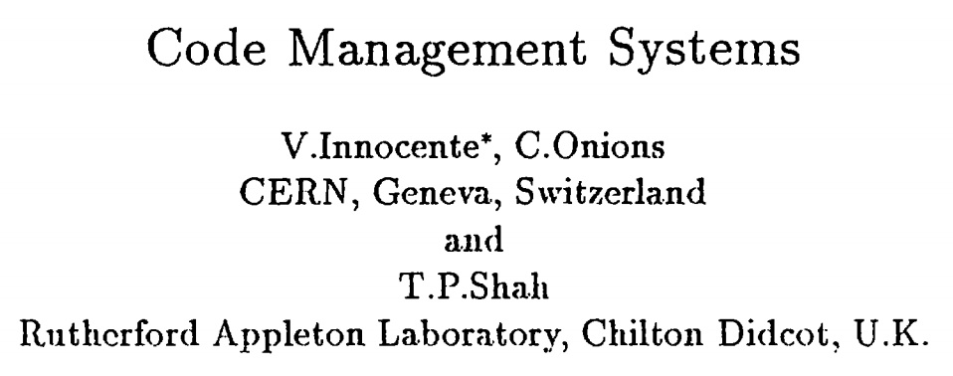
Notes:
These proceedings contain a summary of “code management systems” being used by CERN researchers.

Slide 19
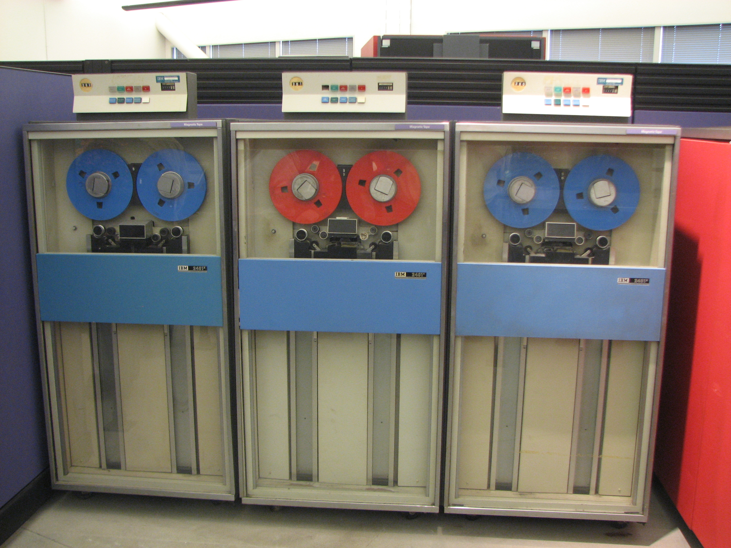
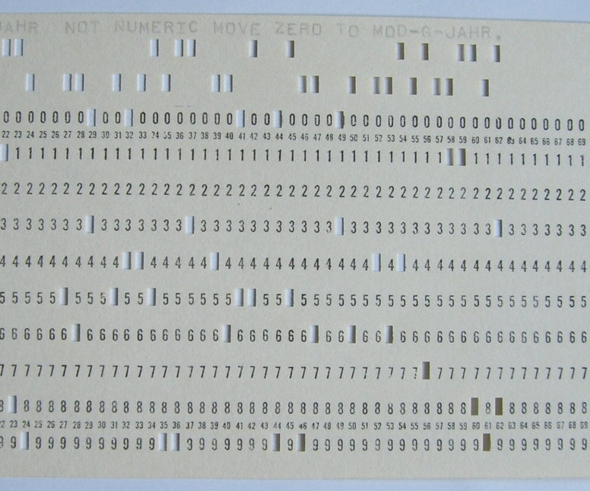
PATCHY
Wikimedia Commons / Erik Pitti
Wikimedia Commons / Rainer Gerhards
Notes:
The first system they mention is called PATCHY which at the time was the most widely used ”code manager” in the high energy physics community.
PATCHY is not a version control system, but it’s an interesting advancement from punch cards. The source code would be loaded onto tape and then correction cards could be fed into the system to update the program on tape. History could be maintained if all changes were made via correction decks.
It’s primary strength within CERN was for distributing code to other sites on tape. Correction decks could also be circulated to update an existing tape, but that was less reliable.
PATCHY is still used today, although I’m not sure how much. I found release notes dated as late as October 2016.
REFERENCE: Don’t read
PATCHY [1] was developed at CERN around 1965 at a, time when programs were fed to the computer via a card reader. By maintaining the source code in a PATCHY Master file (PAM) on tape and using a small cradle of update cards the user was freed from the burden of reading in a tray full of cards! It reads in and acts upon several sequential files by means of cards. PATCHY, because of its origins, is not an interactive program at all. Because it accesses the data sequentially PATCHY is necessarily slow or cumbersome in those facilities best provided by random access.
PATCHY handles common sequences well and conditional code can also be managed but in a slightly more complicated manner. History of code development can only be maintained if all changes are made via correction decks at the start of the PAM file. In particular, if source code is modified directly using the local editor then no history is available (unless done manually by way of a comments deck at the start); there is no automatic way of going back to an earlier version in this case. The updating process cannot be controlled or monitored in any way. PATCHY is very good for distributing code to other sites on tape and correction decks can be circulated for the PAM files in other centers but no guarantee that they would apply to the correct version(s) of the PAM file. PATCHY, as already mentioned, has been the most widely used code manager in the HEP community.

Slide 20
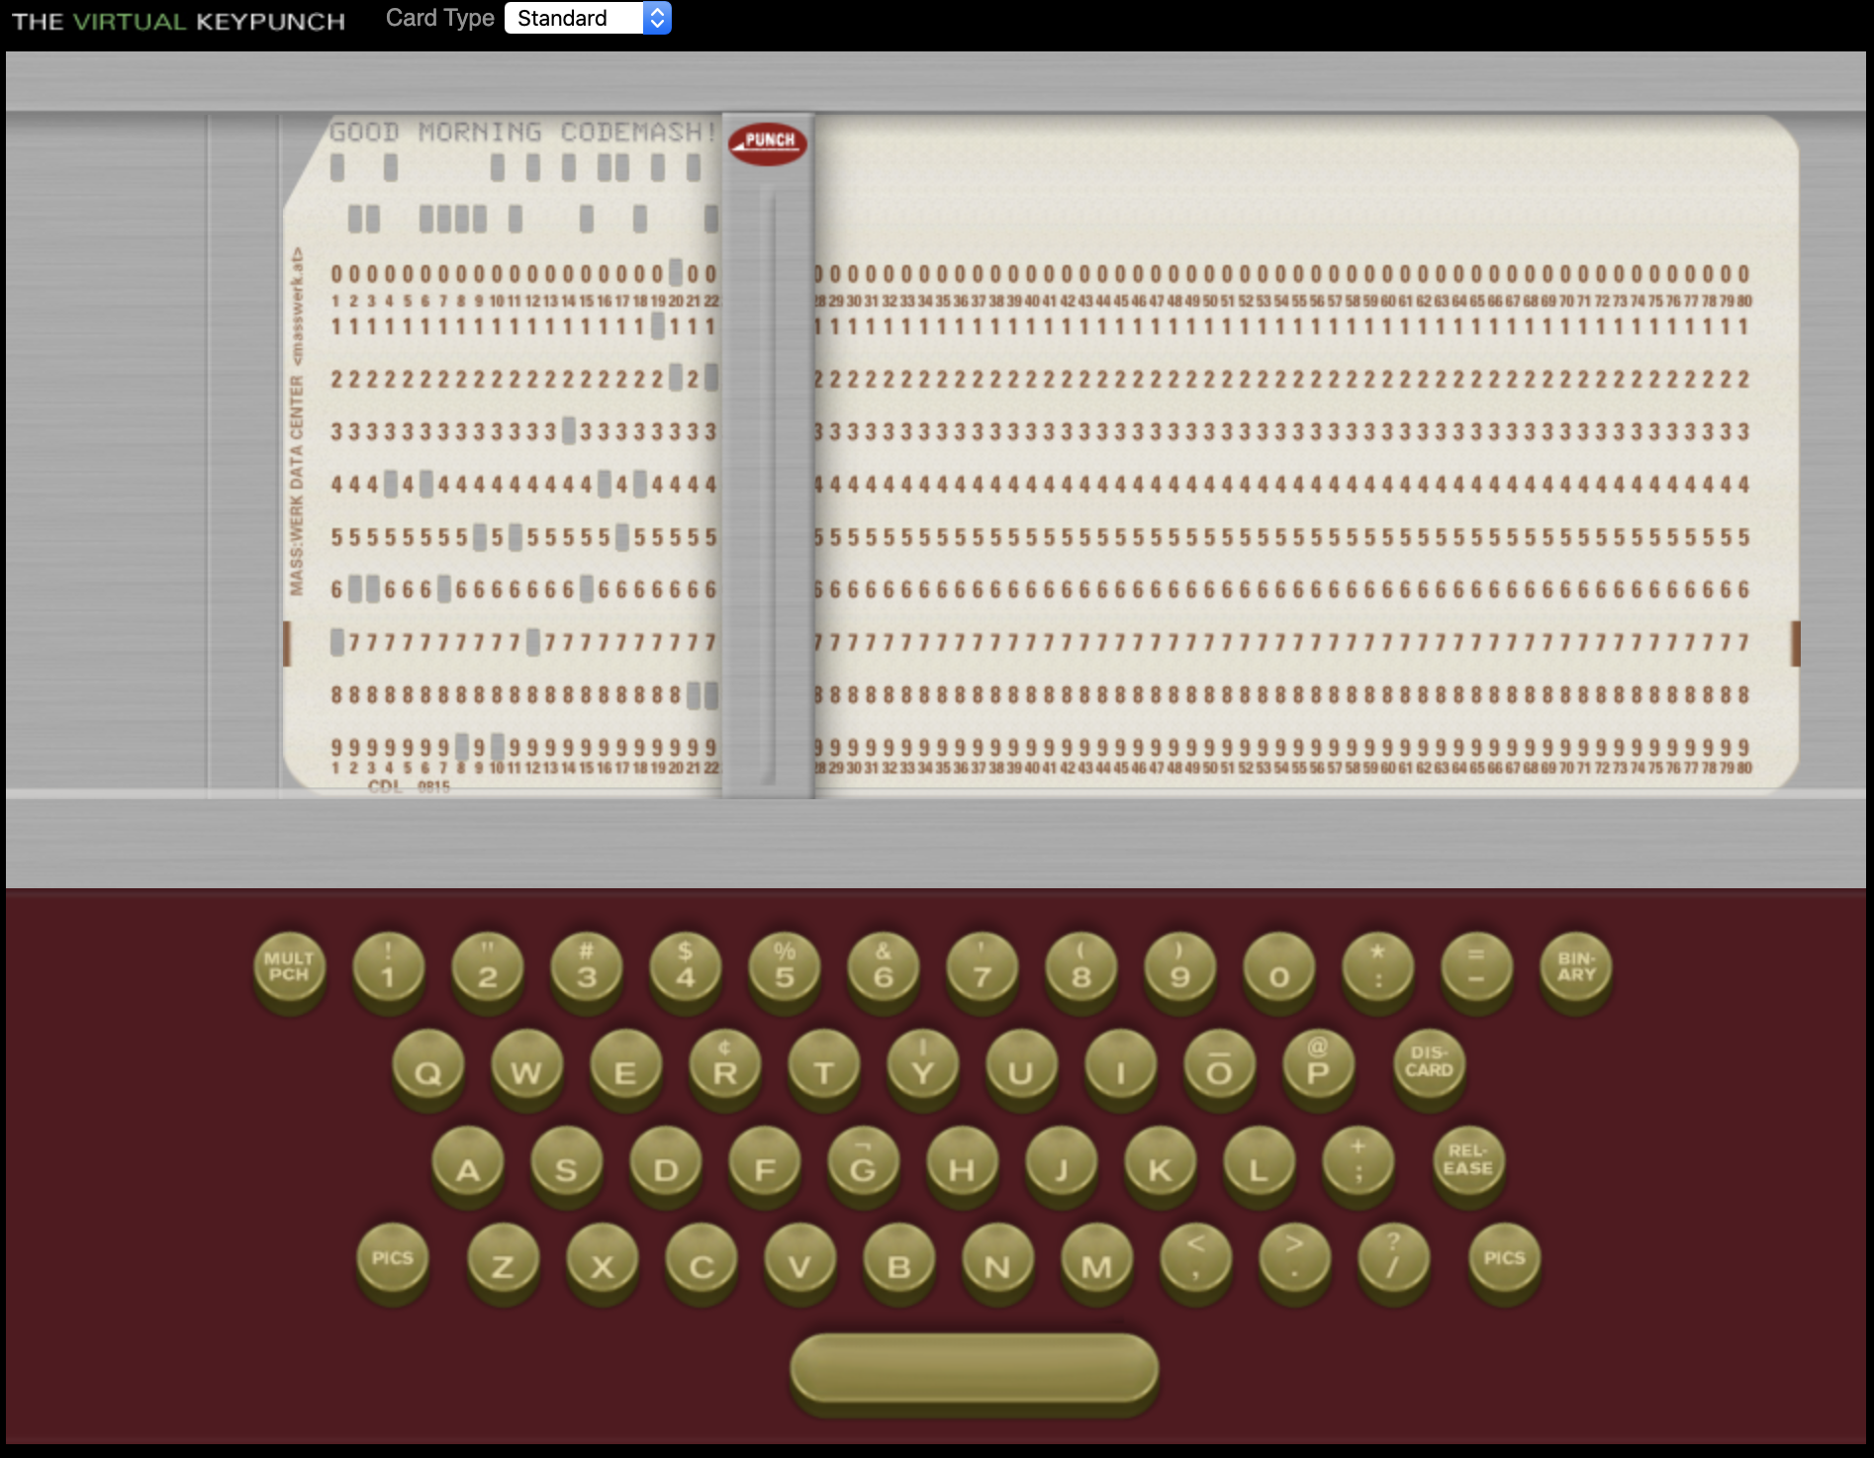
The Virtual Keypunch
https://www.masswerk.at/keypunch/
Notes:
If you want to play around with punch cards yourself, I highly recommend The Virtual Keypunch. Things clicked a lot better for me once I could sit there and virtually type on the keyboard.
But, as far as I can tell, this as far as the punch card world got. Punch cards weren't long for this world though. We were about to enter the world of multi-user operating systems and teletypes. Pretty soon punch cards would begin to fade out and source code would live on the computer itself. Which meant it was time to start looking into software to manage it.

Slide 21
Generations
Generation | Networking | Operations | Concurrency | Examples
First | None | One file a time | Locks | SCCS, RCS
Second | Centralized | Multi-file | Merge before commit | CVS, SVN
Third | Decentralized | Changesets | Commit before merge | BitKeeper, Monotone, Darcs, Git, Mercurial
https://ericsink.com/vcbe/html/history_of_version_control.html#ftn.idp96624

Slide 22
Source Code Control System
SCCS
Notes:
Like most ideas, there are a lot of pre-cursors that had some elements of version control, but it's widely agreed that SCCS (Source Code Control System), not to be confused with SCSS, is the first true version control system. The systems that existed before SCCS were mostly about deltas. And while deltas are extremely valuable, they do not make a version control system.
Before we go any further though, has anybody here actually used SCCS?

Slide 23
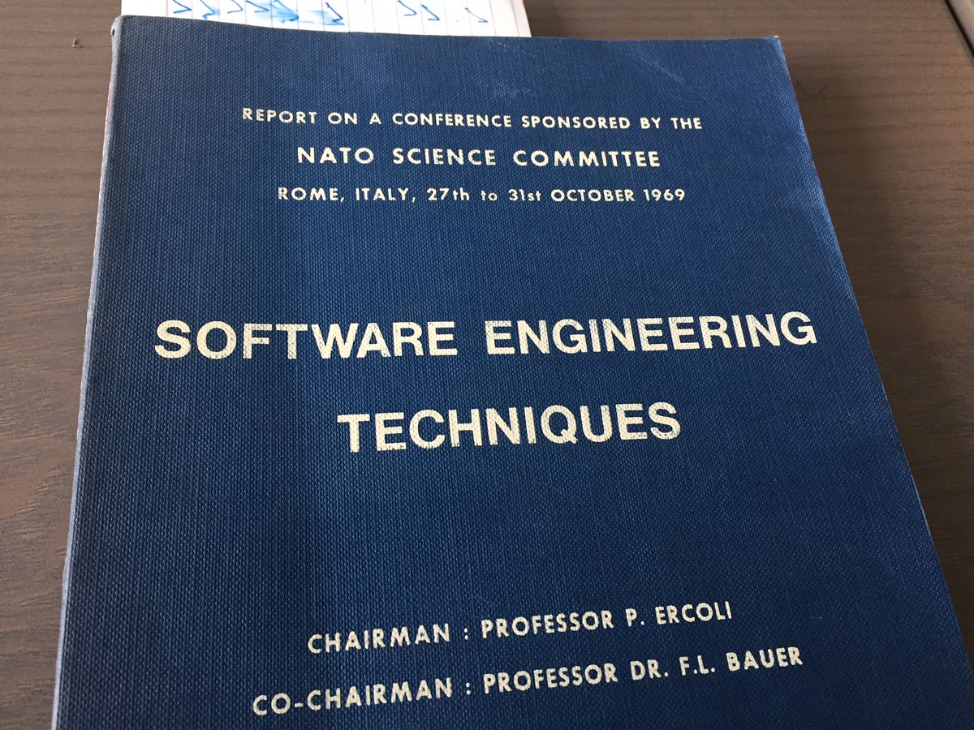
IBM CLEAR
https://twitter.com/bokmann/status/893225721556078592
Notes:
Unfortunately, my research failed me when trying to find any detailed information about pre-cursors to SCCS. I know that systems like IBM's CLEAR (Controlled Library Environment and Resources) and DEC's CMS existed, but I wasn't able to find out much beyond that.
There is a little bit of information about CLEAR from a software engineering technique's conference sponsored by the NATO Science Committee in 1969. CLEAR was a larger system that "tried to assist with the administration and accomplishment of the program development cycle." (http://homepages.cs.ncl.ac.uk/brian.randell/NATO/nato1969.PDF pg. 40) One part of that system used deltas to help with versioning releases, but I was not able to find any other information.
And to go on even more of a tangent, there were two NATO software engineering conferences, this one and one the year before in 1968. The term “software engineering” was not in general use yet. Using the term for to title these conferences was an important step in the giving the term legitimacy.

Slide 24
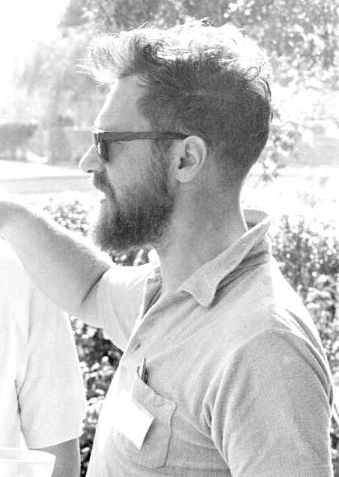
E.W. Dijkstra
Modern Hipster?
Robert McClure & Brian Randell
Notes:
And going even further off the deep end, this is a picture of E.W. Dijkstra from the conference. He’s just a few a tattoos away from being a modern hipster in this picture.

Slide 25

Notes:
Bell Labs logo from 1969-1983
Anybody surprised that the first VCS came out of Bell Labs?

Slide 26
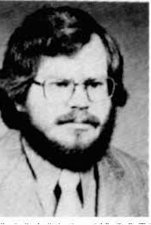
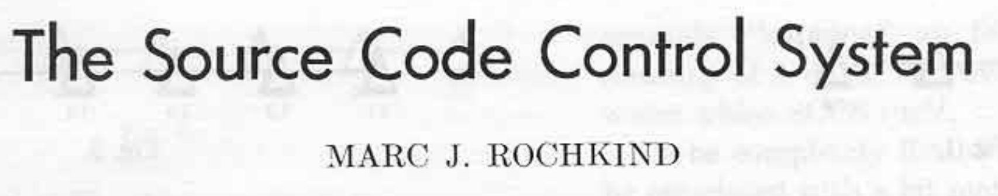
Notes:
The year is 1972 and Marc Rochkind is struggling to deal with change management. In his 1975 paper The Source Code Control System, he describes four problems he was trying to solve.

Slide 27
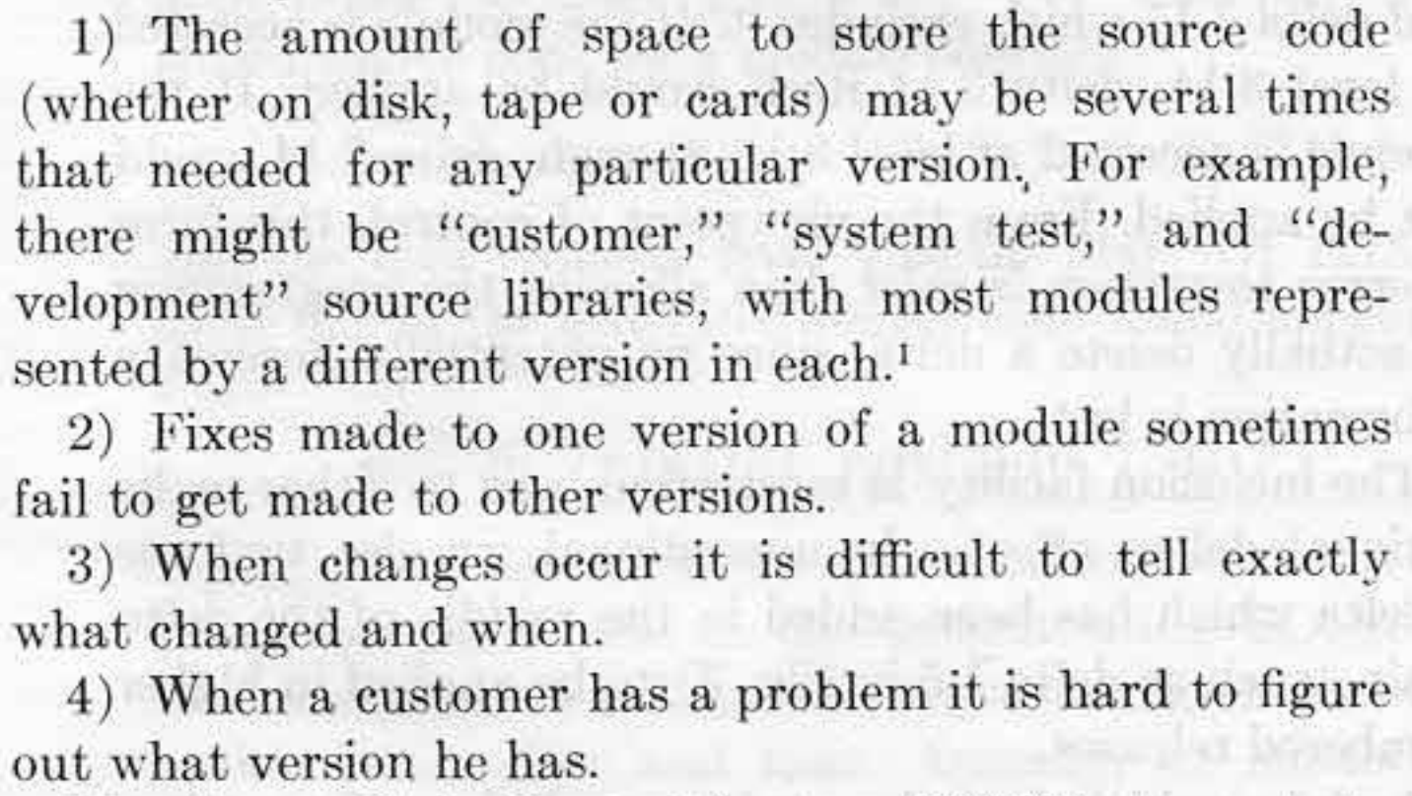
Notes:
I try not to have slides with a lot of words, but I’m making some exceptions for this talk. I just think putting up screenshots from old technical papers is really cool. Don’t feel like you need to read all of that though because we’re going to go through it. These are the problems that Marc was trying to solve in 1972.
1. Save space.
2. Manage versions.
3. Track who changed things and when
4. Knowing what version the customer has.
It's important to remember that memory was precious at this time. The size of files on disk was important, so an efficient storage format was essential.
Distribution of releases was also difficult. There was no internet. Computers were still only owned by large organizations. If you were distributing software, chances are it was an "enterprise" model and customziations for the customer were common. Dealing with versioning of all these releases was a challenge.

Slide 28
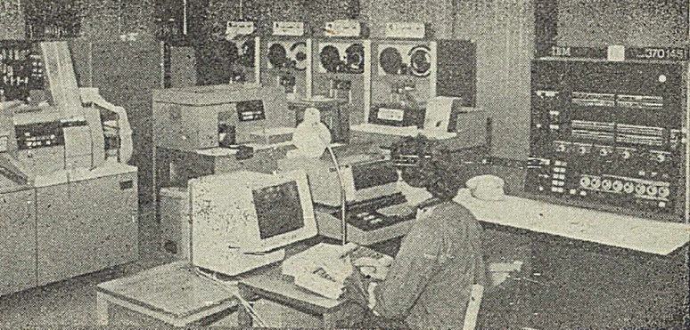
Prototype
SNOBOL: StriNg Oriented and symBOlic Language
SPITBOL: Speedy Implementation of SNOBOL
IBM System/370
OS/MVT: Multiple Programming with a Variable Number of Tasks
Wikimedia Commons
Notes:
The first version was writen in SNOBOL 4 using the SPITBOL compiler for an IBM System/370 running OS/MVT. That's a lot of acronyms.
They felt that the concept of version control was too out there to win people over with a specification, so they prioritized ease of development. SNOBOL 4 was chosen because of it's expressive power and ease of use. For it's day it was an incredibly powerful language. One person was able to write the initial prototype in three months. Depending on the domain you work in, that might seem fast or slow to you, but you have to remember that this is 1972. We stand on the shoulders of giants. This is quite a few shoulders below us.
The downside of SNOBOL 4 and SPITBOL is size and speed, but that wasn't an issue during the six month trial run.

Slide 29
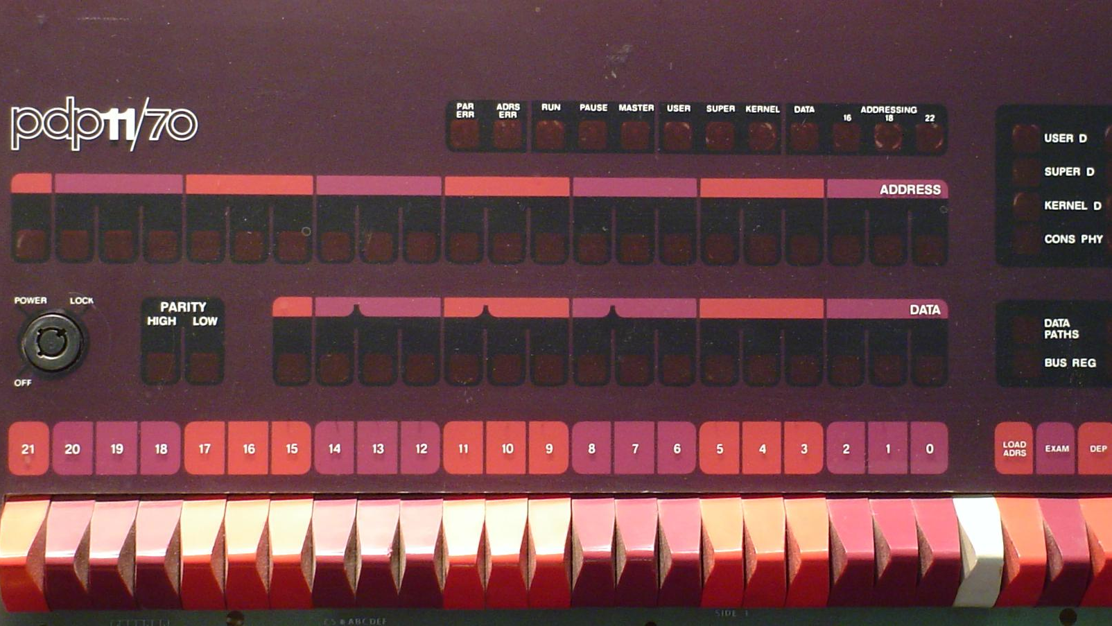
Wikimedia Commons / Dave Fisher
Notes:
The prototype was very successful and several large applications were using it internally. In the fall of 1973 there were several more projects interested in using SCCS and the decision was made to write a new version. The interested projects were on multiple OS's, but the existing version of SCCS only supported OS/360 still. Instead of writing different versions for each OS (which was standard operating procedure then), they decided to write just one version that would run on a PDP 11/45 under UNIX.
Source code would be stored on the PDP 11 and sent to the appropriate machine for compilation. Given the future dominance of UNIX, this turned out to be a wise decision.
This is a picture of a PDP-11/70, which was an upgraded version of the PDP-11/45.

Slide 30
Features
Single file
Locking
Release management
Notes:
So, that's all well and good, but how did SCCS work?
If you remember the features from the first generation, you’ll remember that it only works on a single file at a time, that file gets locked when checked out for editing, and there is no networking.
Working on a single file at a time will probably feel a bit alien to just about everybody in this room. Who here has used a version control system that is focused on individual files? This means your commits are limited to one file at a time. Does anybody here still use a VCS like this, such as RCS?
Release management is interesting though, so let’s talk about that a bit.

Slide 31
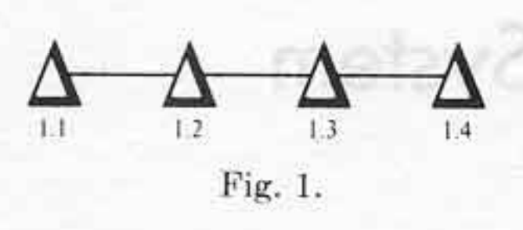
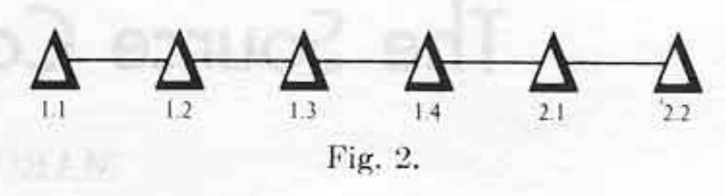
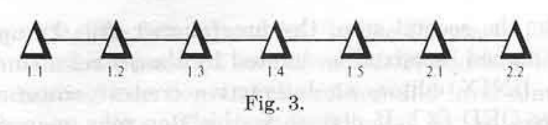
Notes:
These images are from Rochkind’s original 1975 paper, so it felt appropriate to include them to talk about releases.
I mentioned that managing the versioning of releases was a very big problem that SCCS hoped to tackle. It did this through the concept of releases and levels. Each commit would increment the level of a release. For example, when you create a file, it is at Release 1, Level 1, or 1.1. Committing a delta would increment the level to 2, so now we're at 1.2. The release number would only increment if you explicitly started a new release with `edit -r`.
You had a lot of power over managing those releases. For example, if you needed to make a fix to release 1, but release 2 is the most recent, you could explicitly checkout the latest level from release 1 and make a change. That change would not apply to release 2. You would have to make the change in release 2 by yourself if necessary. This was not actually the original behavior though. In this example, 1.5 was added. That delta would have been included in release 2. They originally thought this was a good idea, but experience taught them otherwise. This means that, in the diagram, 1.5 is NOT part of release 2 because it was added later. There’s no concept of branching here. Everything is linear.
You also had a lot of power to search and display history, but I'm not going to dive into that here.

Slide 32
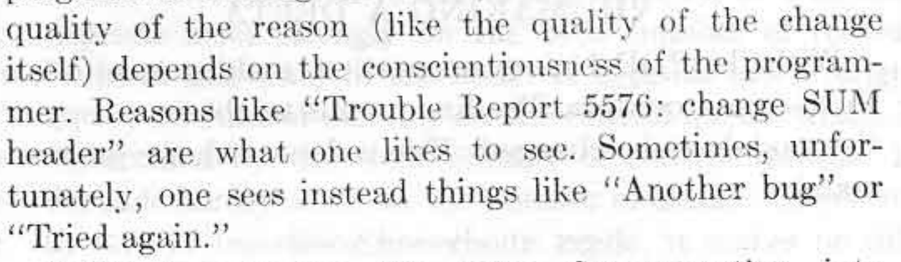
Notes:
In 2020 we have mastered informative and conscientious commit messages, right? I’m assuming none of you work on teams that commonly use commit messages like this. /sarcasm
Even in 1975 Rochkind was lamenting the lack of good commit messages.

Slide 33
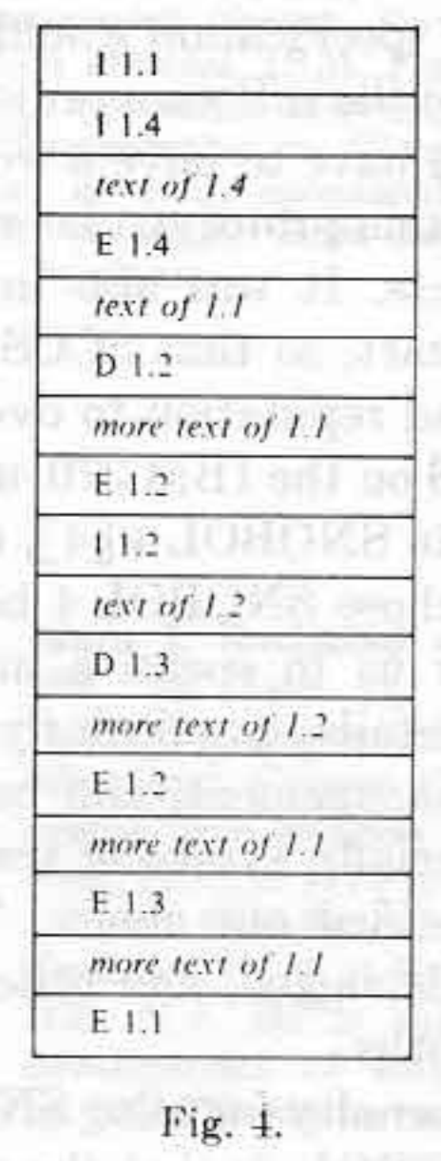
Interleaved Deltas
The attempt by SCCS to record every version of every module that ever existed is rather ambitious. The system would be impractical unless it used a storage technique and accessing algorithm that allowed many deltas to be kept at a reasonable cost in terms of disk space and processing time.
- Marc Rochkind (The Source Code Control System)
Notes:
I don't want to dive too deep into implementation details with every system that I discuss today, but I do think it's important to talk a bit about how SCCS worked to set a baseline for comparison. Plus it's a great excuse to dive into old papers.
The core of SCCS is something called interleaved deltas. In the paper, Rochkind describes the problem he was trying to solve. (Quote on slide)
Interleaved deltas satisfied both requirements. The space required to store the delta is only slightly greater then the amount of text inserted by the delta. Access speed was mostly flat. Any level could be reached in equal time.
All changes are stored with just two primitives. Lines are either being inserted or deleted. This should still be familiar today, because that is how diff works. Each module is a separate sequential file. The deltas are stored in the body. The body consists of text records and control records. Text records contain the source code. Control records specify the effects of each delta.

Slide 34
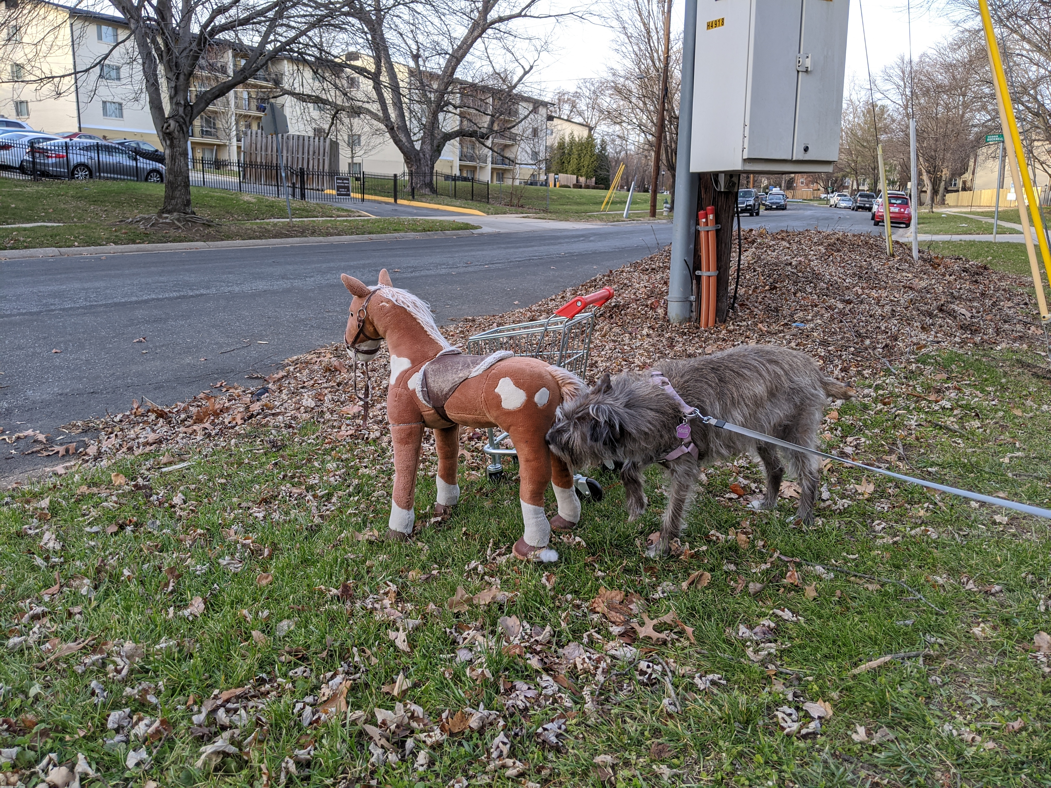
Pamela Vong
Notes:
In 2015, Marc Rochkind sent an email to a mailing list outlining how he came up with the algorithm for interleaved deltas. I love this story because it shows that even in 1972 computer programmers were solving thorny problems by getting away from their work. (http://sccs.sourceforge.net/sccs_invention.html)
Marc was walking his girlfriend's dog. Marc didn't like the dog, so he would let his mind wander when walking it. He had been struggling with the problem of how to store both the source code and the deltas all in the same file. He came up with the idea of surrounding the pieces of text with markers. When he got back to his apartment, he started sketching out details of how it might work.
When he thought he had a workable solution, he enumerated what he thought were all the possible cases of insertions mixed with deletions and worked through each example. From there it was pretty simple to code and he had that part of SCCS running in SNOBOL4 in a day or two.

Slide 35
SCCS Today
http://sccs.sourceforge.net/
https://www.gnu.org/software/cssc/
Notes:
As the first "real" version control system, SCCS was obviously extremely influential, but it also had a surprisingly long life-span. The project started in 1972 but didn't have it's first public release until version 4 on February 18, 1977. It even ended up becoming part of the Single UNIX Specification. It's still part of the POSIX standard, which really makes me wonder what other sort of random, irrelevant by-today's-standards utilities are part of POSIX.
You can still find a modern fork of SCCS that was open sourced by Sun as part of OpenSolaris on SourceForge. That site is actually a treasure trove of information. For example, it contains the version 4 release announcement from 1977. It contains important information, such as SCCS files now being stored as ASCII instead of binary. We can also see that it was still being distributed as part of a larger tool suite called Programmer's Workbench (PWB).
You can also find a link to the SCCS development mailing list! It had a grand total of... one message in 2019. Asking if Windows 10 support was planned.
GNU also provides CSSC, which is their version of SCCS. The source code of course lives in a git repository. It was converted from CVS to git in 2010. There is actually one dev (James Youngman) actively making contributions to it this past year. The intent of the project is to help convert old SCCS repos over to a more modern option.

Slide 36
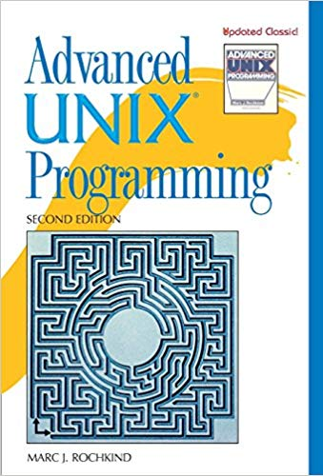
Marc Rochkind
https://basepath.com/
Notes:
Today, you can find Marc Rochkind’s work on his website. I’m not completely sure what he’s doing these days, but, based only his website, it appears that he keeps busy with a wide range of hobby projects.
Something else that will be a bit of recurring theme today is that a lot of the people I’m going to talk about or also well known for other things. In this case, it’s for Advanced UNIX Programming.

Slide 37
Revision Control System
RCS
Notes:
Who here has ever used RCS? I can actually raise my hand for this one. During the summer of 2006 I was an undergraduate research assistant. All of the source code and LaTeX for the research's paper was stored in RCS. I didn't know much about version control in 2006, but I remember raising my eyebrows about it even back then.

Slide 38
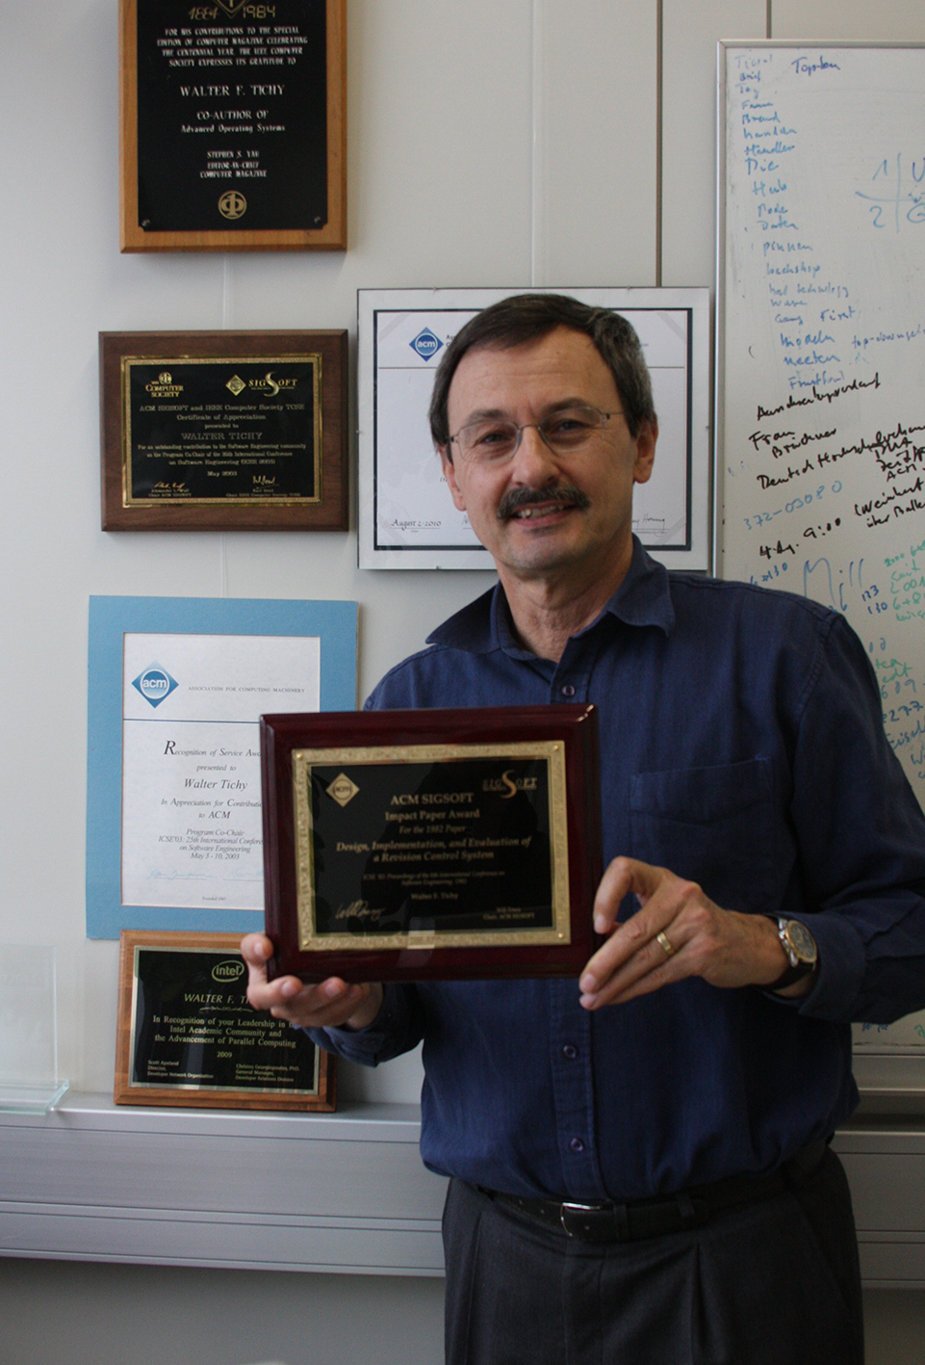
Walter F. Tichy
Karlsruhe Institute of Technology
Notes:
Tichy, born in 1952, is a German computer scientist who received his MS and PhD from Carnegie Mellon in 1976 and 1980 respectively. After that he served for six years on the faculty of Purdue University. It was during his time at Purdue that he developed RCS.
This picture is him with the ACM SIGSOFT Impact Award he received in 2013 for...

Slide 39
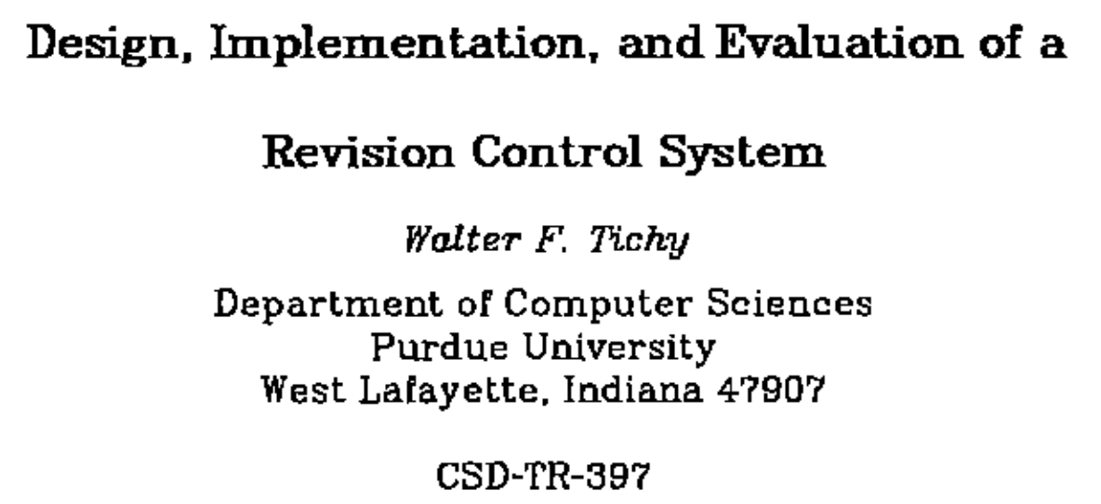
Notes:
...this paper. The Association for Computing Machinery (ACM) bestows this award every year for a publication that has demonstrated major impact.
So, why did Tichy create RCS and what advantages did it have over SCCS? Let's look at his 1982 paper Design, Implementation, and Evaluation of a Revision Control System.

Slide 40
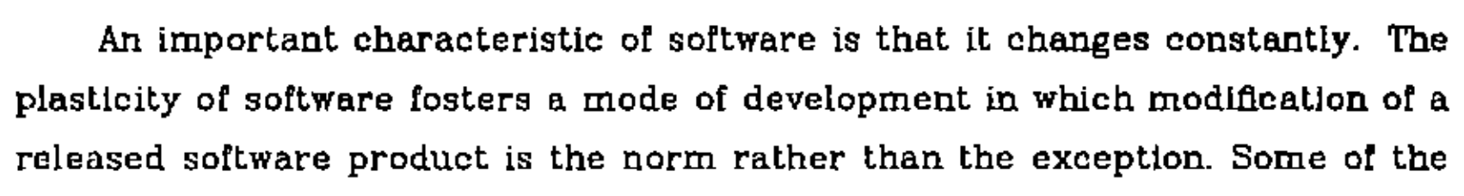
Notes:
Right away in the introduction we get reminded that even in 1982 software was never done. He goes on to state that “ ’Improved’ versions of heavily used software products seem to arise almost spontaneously.”

Slide 41
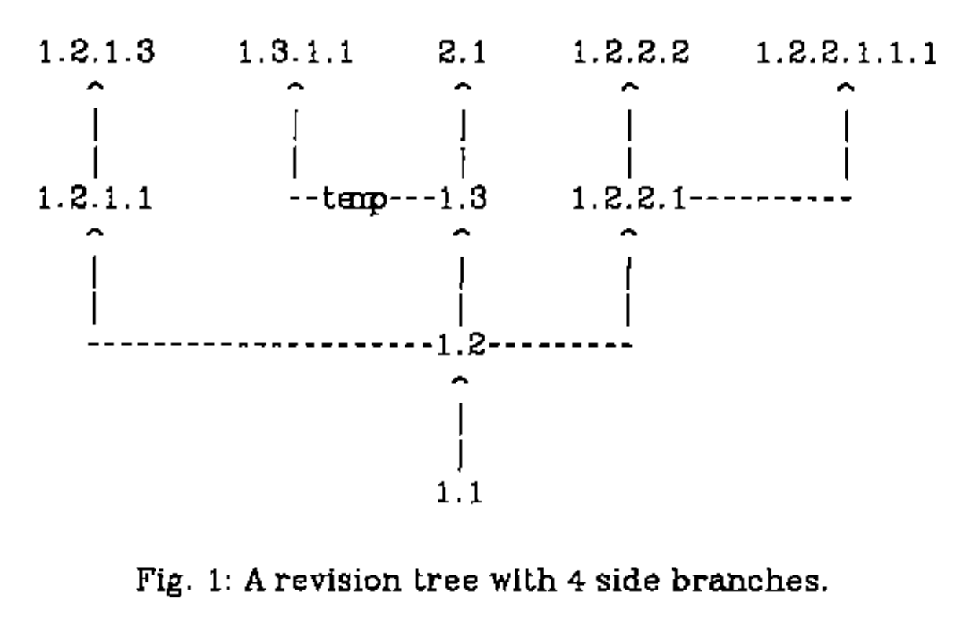
Notes:
At it’s core, RCS is a refinement on SCCS. Both are 1st generation tools. You check files in and out. You lock files. Revision numbers are very similar. Also, similar to SCCS, you can do some reasonably powerful searching to checkout a specific revision by criteria beyond an exact revision number.
There are differences though. The first one is branching. SCCS did not have any concept of branching, but RCS does.
This is an example of branching. We can see that each fork appends another number to the version. You can also give a friendlier label to the branches as an alias. One possible usage for this is to manage releases. You could create a labeled branch for every file and then retrieve every file with that label. SCCS did not provide the ability to provide friendlier labels like that.
I was not able to find any information about how often it was used, but my guess is not often.

Slide 42
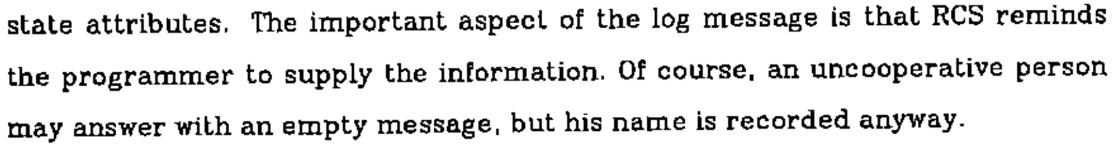
Notes:
Software developers. Providing poor commit messages since the dawn of version control itself.

Slide 43

Wikimedia Commons
Notes:
There were also some auxilary commands. The most interesting of them is _rcs_, which lets you break locks. Even using RCS on a very small project in college, people forgot to release locks on a regular basis. Interestingly, breaking the lock also sends an email to the person who held the lock.
SCCS also supported breaking locks, but you needed special permissions to do so. In practice, everybody ended up getting these permissions so RCS just got rid of them.

Slide 44
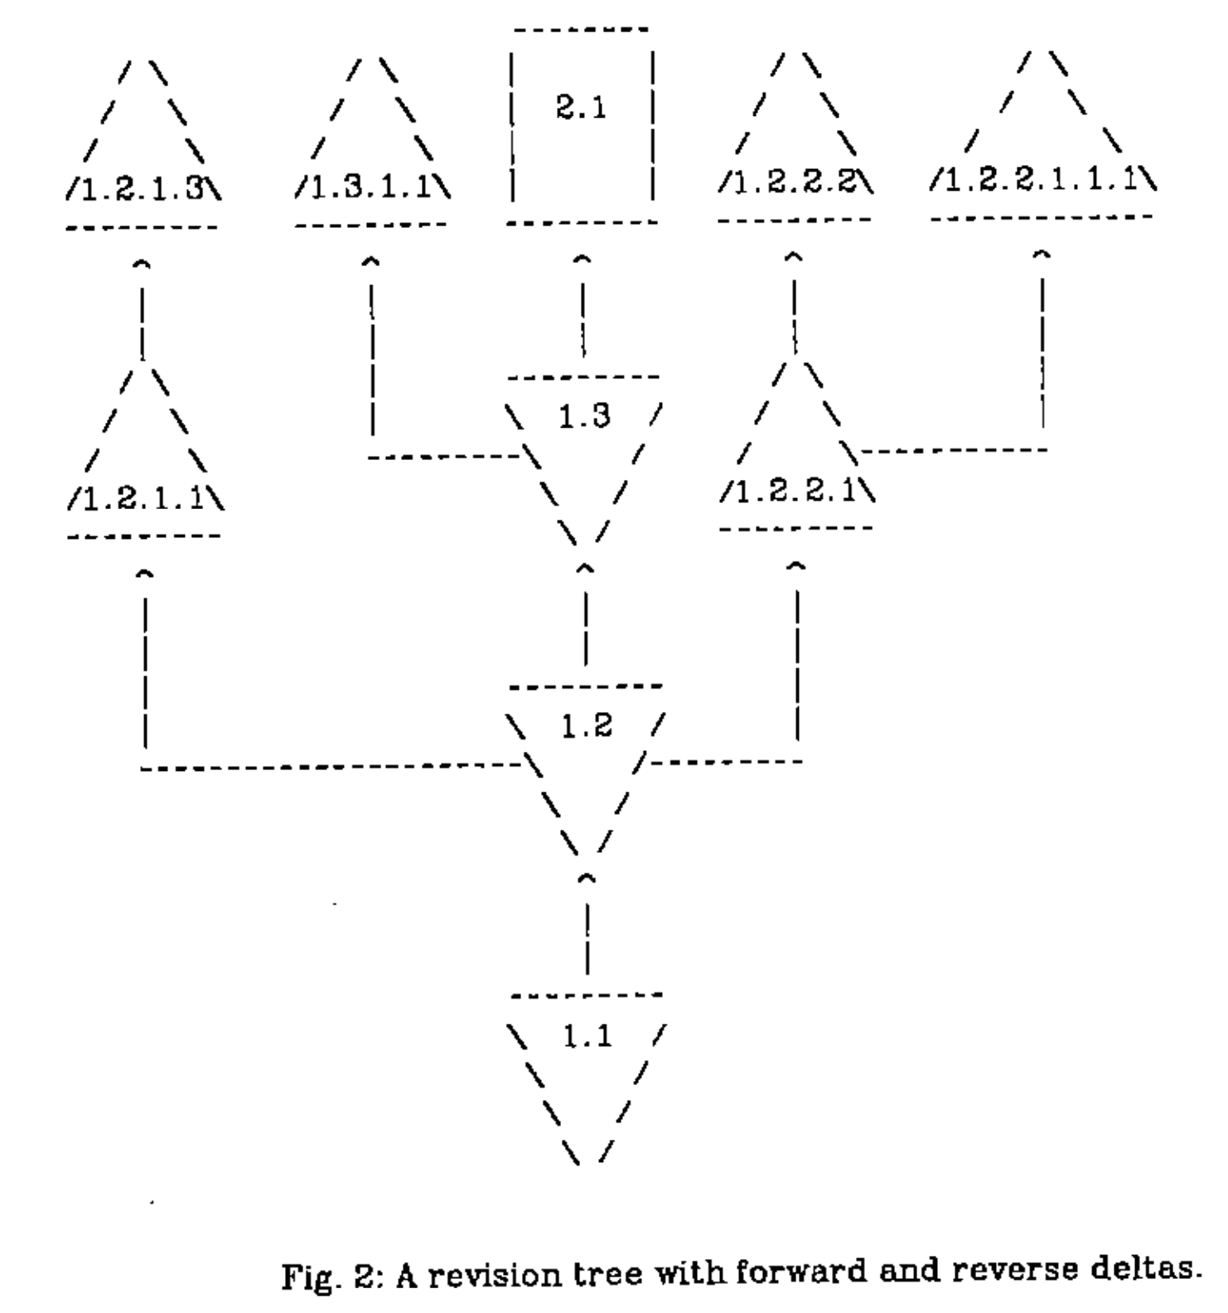
Reverse Deltas
Notes:
RCS departs from SCCS in the way it stores deltas. SCCS stored all the deltas interleaved with each other. Interleaved deltas have a couple of performance characteristics.
* The time it takes to retrieve any revision is the same. The whole revision file must be scanned no matter what.
* Inserting a new delta is more complicated. First the old revision must be regenerated, diff'd with the new revision, and then the new delta info in interleaved.
RCS instead uses reverse deltas. The newest revision is stored intact, since that is what you will usually want to check out. If you want to go back one revision, you take the newest revision and apply a reverse delta to go back to that revision and so on to go back to any revision in the history. Adding a new revision is just getting the latest revision and executing diff to get the reverse delta. Then concatenate new revision and the new reverse delta to the already existing deltas. Done.
Of course, the disadvantage here is that going further back in history is more expensive. There is also additional complexity with branching with forward deltas being used on non-trunk branches for storage reasons.

Slide 45
Other Differences with SCCS
MAKE integration
Access controls
Identification
Merging
No Checksums
Notes:
A big advantage of RCS is that it was designed to be easily used with MAKE. SCCS pre-dated MAKE, so it was unnecessarily difficult to integrate the two. The big difference is that the file naming conventions of RCS were designed to be easily used with MAKE.
Tichy also noted that the access control of SCCS could be too strict. In practice, everybody ended up needing the extra privilege of needing to break locks, but breaking a lock left no trace. This led to RCS allowing anybody to break a lock, but sending an email to the holder of the lock when it is broken.
Also, he notes that the identification mechanism (_sccsid_) is not used in practice because of it's complexity. His hope was that RCS's system would be much easier to use, but I don't have any information on how true that was.
SCCS provided no mechanism for merges either. RCS branches do support merging, but it's not clear how good that was in practice. Wikipedia implies that teams mostly used locking on a single head branch instead of branching. That seems likely, but I did not attempt to validate that claim at all.
One big thing that RCS was missing (at least in 1982. I didn't check if it was added later), is checksumming. SCCS did this.

Slide 46
Original License
Copyright (C) 1982 by Walter F. Tichy [...] All rights reserved. No part of this software may be sold or distributed in any form or by any means without the prior written permission of the author.
Notes:
RCS is also a bit of case study in the evolution of open source licenses. Through version 3, which was distributed in BSD 4.3, it had the following license.
This license looks crazy today. You needed the explicit written permission of Walter F. Tichy to distribute RCS! This was true until 1989 when the license was altered to

Slide 47
1989 License
Redistribution and use in source and binary forms are permitted provided that the above copyright notice and this paragraph are duplicated in all such forms and that any documentation, advertising materials, and other materials related to such distribution and use acknowledge that the software was developed by Walter Tichy.
Notes:
This is pretty similar to BSD licenses of the day. It's just missing anything about using the Walter Tichy's name to endorse or promote derived products and anything about the software being provided _as is_.
With RCS 4.3 on July 26, 1990 it became distributed by the Free Software Foundation under the GPL.

Slide 48
RCS Today
https://www.gnu.org/software/rcs/
Notes:
Today RCS is a GNU project and easily installable as a package through Homebrew on a Mac or your package manager of choice in Linux. The latest release was 5.9.4 on January 22, 2015. The project is currently maintained by Thien-Thi Nguyen.
Tichy is still an active professor in Germany at the Karlsruhe Institute of Technology in Germany.

Slide 49
Generations
Generation | Networking | Operations | Concurrency | Examples
First | None | One file a time | Locks | SCCS, RCS
Second | Centralized | Multi-file | Merge before commit | CVS, SVN
Third | Decentralized | Changesets | Commit before merge | BitKeeper, Monotone, Darcs, Git, Mercurial
https://ericsink.com/vcbe/html/history_of_version_control.html#ftn.idp96624

Slide 50
Concurrent Versions System
CVS
Notes:
Which brings us to CVS. So, who here has used CVS? When did you last use it and where?
Personally, my experience with CVS is minimal. The most I’ve ever done with it is checking out projects from SourceForge. I think.

Slide 51

Notes:
Wrong CVS

Slide 52

Dick Grune
https://dickgrune.com
Ilana Grune
Notes:
CVS can be said to have two creators. The initial creator was Dick Grune.
Dick Grune was born in 1939 in Enschede, the Netherlands. He got his Master of Physics in 1967 from Rijksuniversiteit Utrecht. From there he worked in Israel as a systems programmer for a couple of years before starting research in Amsterdam. He got his PhD in Computer Science in 1982 from the University of Amsterdam. He spent the rest of his career at Vrije Universiteit, Amsterdam before retiring in 2004.
Dick Grune created the initial version of CVS in 1984-1985. The details are a bit fuzzy.

Slide 53
Origin
I created CVS to be able to cooperate with my students, Erik Baalbergen and Maarten Waage, on the ACK (Amsterdam Compiler Kit) C compiler. The three of us had vastly different schedules (one student was a steady 9-5 worker, the other was irregular, and I could work on the project only in the evenings). Their project ran from July 1984 to August 1985. CVS was initially called cmt, for the obvious reason that it allowed us to commit versions independently.
Dick Grune https://dickgrune.com/Programs/CVS.orig/#History
Notes:
When this project finished, he cleaned up the shell scripts and renamed it CVS. These shell scripts were just wrappers over RCS. The initial commit of CVS under itself was on November 23, 1985.

Slide 54
Original CVS Scripts
This is CVS, Concurrent Versions System, a front end for RCS. It supports the concurrent and independent use of an RCS directory by several people. We have been using it for half a year now, on various projects. It uses the RCS programs rcs, ci, co, rcsmerge and rlog in such a way that you can do a multi-file commit, etc. It is all shell scripts.
-Dick Grune (June 23, 1986) https://groups.google.com/forum/?hl=en#!original/mod.sources/eqze_AHbIK0/uE90wCq3ui4J
Notes:
He posted the improved scripts to comp.sources.unix on June 23, 1986. You can still find those online today and it still works, assuming you have RCS installed.

Slide 55

Brian Berliner
https://twitter.com/berliner
Notes:
From there, Brian Berliner comes into the picture.
Brian Berliner received his BS in Computer Science from the University of Illinois in 1985. He's had a long career working on supercomputers, CVS, and business systems. He's been a founder and an executive. Advisor and board member. He's been busy.
Brian Berliner took those original scripts and ported them to C in roughly two weeks. This port turned into the official CVS. He started it in April 1989 with input from other contributors while working at Prisma. Prisma was a third-party developer working on the SunOS kernel. His port was released under the GPL and CVS 1.0 became a Free Software Foundation project on November 19, 1990. It's relationship with GNU is a bit murky. Some GNU pages called it a GNU project and others did not.

Slide 56
CVS II: Parallelizing Software Development
https://docs.freebsd.org/44doc/psd/28.cvs/paper.pdf
Notes:
Berliner summarized his work with on CVS with Prisma in a paper that you can find at this link.

Slide 57
Advances Over RCS
Work with multiple files at once
Client-server architecture
Concurrent edits
Notes:
CVS was the first version control system of what became known as the second generation. All of these advantages are defining characteristics of the second generation.
* The ability to work with multiple files at once. Files are still versioned independently, but you can commit multiple at once. The huge shortcoming of this is that those commits are not atomic. You are not guaranteed that all of them or none of them will succeed. Any number could succeed or fail.
* Client-server architecture. The server contains the centralized repository and clients talk to that repository to check code out, commit code, and other operations. The server is the centralized point of truth and all operations must go through it.
* Concurrent edits. File locks are no longer necessary. Instead, multiple developers may work on a file at once. If developer A commits first, then developer B will be required to pull the new changes in first and resolve conflicts if necessary before they are able to commit their changes. If there are no conflicts, then this process is transparent.

Slide 58
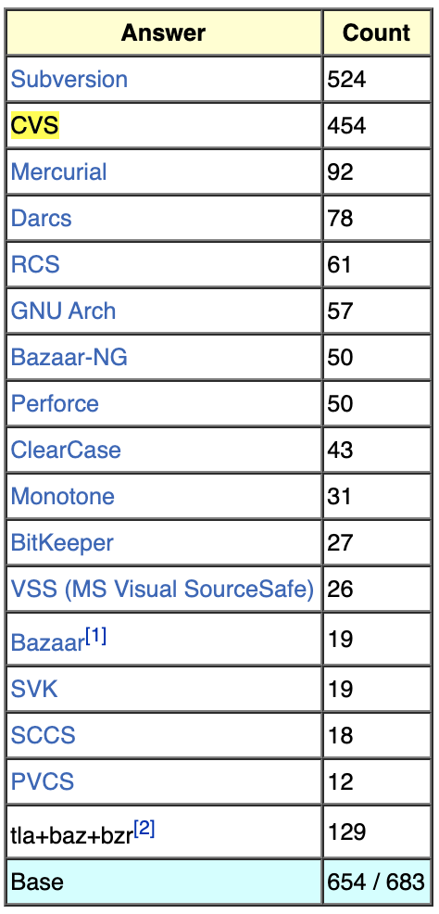
CVS Adoption
http://git.wiki.kernel.org/index.php/GitSurvey2007
Notes:
Unfortunately I was not able to find any hard data on CVS adoption, but I've found enough indirect evidence that I'm willing to state the CVS was the dominant version control system of the 90's.
A 2007 survey by git of it's users found that CVS and SVN were by far the most common version control systems that git users also had experience with. This is not the most representative sample though. An early adopter of git is probably not representative of the average developer.
CVS became the de facto standard for open source development. There were competing paid products, such as Perforce, ClearCase, and Visual SourceSafe, but they never became as ubiquitious as CVS. Although, I think that Perforce did offer free licences to open source projects.

Slide 59
CVS Today
Notes:
CVS predates the concept of every project having a logo.
Today, I would consider CVS to be a dead project. The last release was 1.11.23 on May 8, 2008. There have been some maintenance bug fixes since then, but no releases. The last checkin was on March 30, 2011.
There is a fork called CVSNT that began in 1998 with the initial goal of improving Windows support. I assume this is where the "NT" comes from. Its history is extremely messy. It's not that important, so I won't go into it. Suffice to say, if you wish, you can pay for a commercial version of CVS today.
The real future of CVS was... (SVN)

Slide 60

Notes:
So, who here has used SVN? When did you last use it and where? Personally, I used SVN for the first time in college on a group project. Another member of the group that I hadn't worked with before used it on all of his projects, so the entire team adopted it. I would go on to use it from 2007-2010 at my first job out of college.

Slide 61
Wayback Machine: collab.net (Oct. 16, 2000)
Notes:
The Subversion project was started in 2000 by CollabNet with the explicit goal of making CVS, but better. CollabNet offered a software suite called CollabNet Enterprise Edition (CEE), which included version control. They were using CVS for that part, but the limitations were obvious. Unfortunately, CVS had become so ubiquitous that there wasn't a better open source option.

Slide 62

Karl Fogel
Karl Fogel & Mike Pilato
Notes:
There are few people who are most responsible for the early design and development of the project. These are Karl Fogel, Jim Blandy, and Ben Collins-Sussman.
Karl Fogel was the author of Open Source Development with CVS. He had already been discussing a design for a new version control system with Jim Blandy. Those two had previously founded Cyclic Software in 1995 to provide CVS support contracts, so they were well aware of the strengths and weaknesses of CVS.

Slide 63
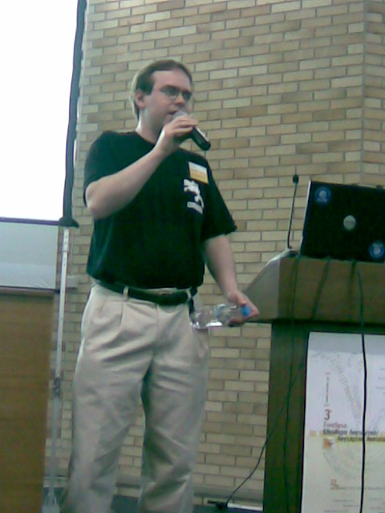
Jim Blandy
Panos Astithas
Notes:
In February 2000, CollabNet reached out to Karl Fogel to ask about his interest in working on a version control system to replace CVS. By coincidence Karl and Jim were already discussing such a system, Karl immediately joined. Jim was working for Red Hat Software at the time and convinced them to essentially donate him for an indefinite period of time to work on the project. CollabNet also hired Ben Collins-Sussman at this time.

Slide 64

Ben Collins-Sussman
https://www.red-bean.com/sussman/
Notes:
Their initial goals were simple. Jim already had a name, Subversion, and a basic design for the data store from his previous musings with Karl. They didn't want to break any new ground, they just wanted to fix CVS. They wanted to match CVS's features and development model, but avoid the big flaws. It didn't need to be a drop-in replacement, but it needed to feel very familiar to a CVS user to make the transition relatively painless.
Subversion became self-hosting on August 31, 2001, after 14 months of development. Up until this point the code was actually managed with CVS.

Slide 65
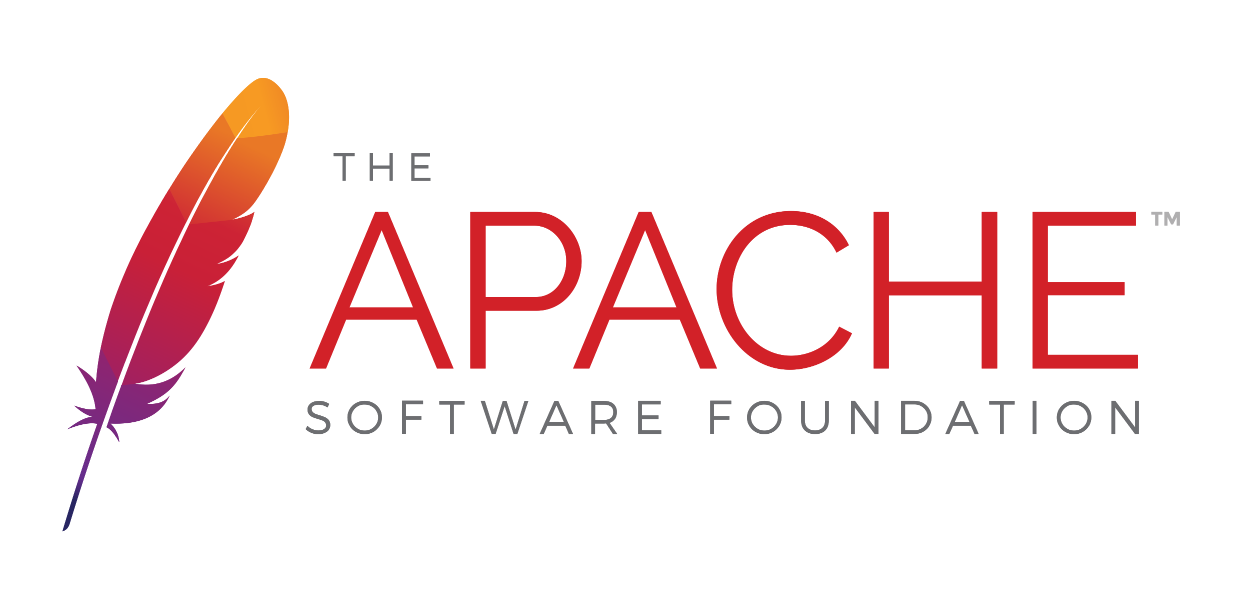
Notes:
In November 2009, Subversion was accepted into Apache Incubator. Things moved quickly and it became a top-level Apache project on Feburary 17, 2010. It remains an Apache project to this day.

Slide 66

Brian Behlendorf
Faces of Open Source / Peter Adams
Notes:
One major factor in Subversion becoming an Apache project was Brian Behlendorf. He was one of the founders of CollabNet, along with

Slide 67

Tim O’Reilly
Faces of Open Source / Peter Adams
Notes:
...Tim O'Reilly (yes, the one you're thinking of) and Bill Portelli. Behlendorf is best know for being the primary developer of the Apache Web Server and founded the Apache Group, which became the Apache Software Foundation.

Slide 68
Advantages over CVS
Atomic commits
Directories, renames, and moves
Local operations
Branches and tags
Metadata
Binary files
Notes:
The entire goal of Subversion was to create a fixed version of CVS and they succeeded in that.
* The entire repo is revisioned, not individual files. Getting the repository status at a single point in time is just one version number. This also gives you atomic commits.
* Directories are versioned as well. You can run svn commands on them.
* Support for renames and moves.
* Limited support for local operations, such as the status of changes you have made, a diff of your changes, and reverting your changes.
* Branches and tags are just ordinary directories within the filesystem.
* Support for arbitrary metadata on files and directories with _propget_ and _propset_
* Better support for binary files. It stores a binary diff instead of full copies like CVS does.

Slide 69
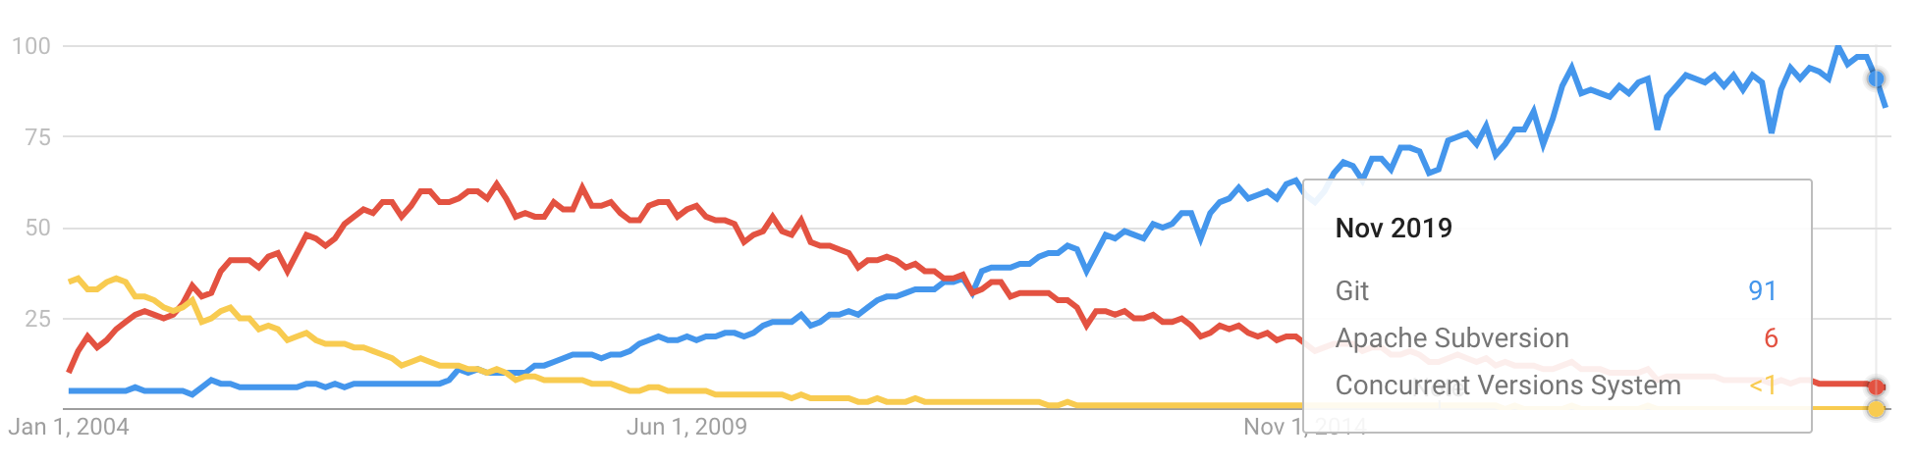
Adoption
Notes:
Subversion 1.0 was released on February 23, 2004. I was not able to find any hard adoption numbers for Subversion, but Google Trends shows Subversion coming out ahead relatively quickly after the 1.0 release. I'll note that comparing Google Trends with the search term _CVS_ is not as straightforward as one would wish because

Slide 70
Notes:
I do feel comfortable stating that Subversion quickly replaced CVS though.
Subversion has definitely fallen out of favor today but remains the most widely used centralized version control system. It's still actively developed. Version 1.13 was released on October 30, 2019.
Stepping back a bit though, I think it’s important to note that Subversion is the first “modern” Open Source VCS developed that way from the start. SCCS was developed at Bell Labs and was internal project for years. RCS had Walter F. Tichy’s own license. CVS was a bunch of scripts dumped into USENET. SVN was the first VCS developed in the open in the modern sense of the OSI approved definition of open source.

Slide 71
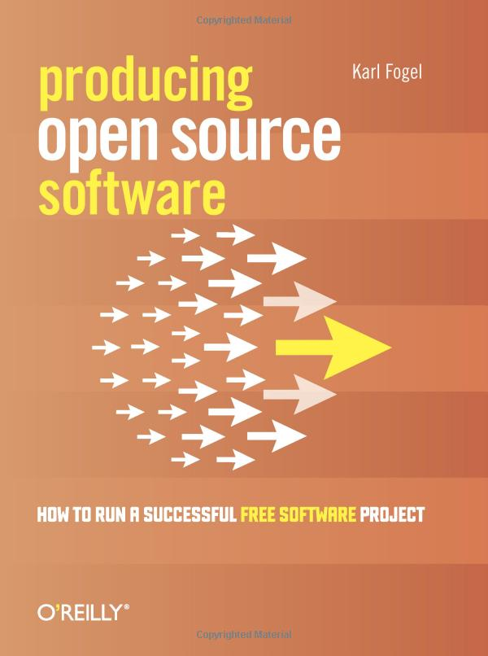
Karl Fogel
https://questioncopyright.org/
https://opentechstrategies.com/
Notes:
Karl Fogel would go on to write _Producing Open Source Software: How to Run a Sucessful Free Software Project_. He would draw on his experience with Subversion a lot during the book. He currently is a partner at Open Tech Strategies, LLC, where he helps organizations launch and participate in open source projects.
In addition, he founded QuestionCopyright.org, a non-profit that advocates for copyright reform.

Slide 72
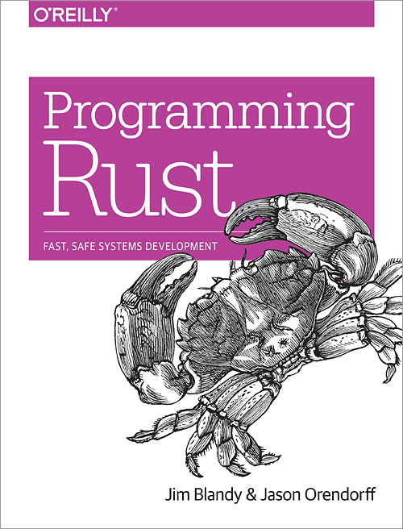
Jim Blandy
Mozilla
GNU Emacs
GNU Guile
GDB
Notes:
Today, Jim Blandy works for Mozilla. He is one of the authors of Programming Rust. In addition, he has also been the maintainer of GNU Emacs, GNU Guile, and GDB.
Apparently Guile is the preferred extension language system for the GNU Project. It’s an implementation of Scheme. Looks cool, but not actually used that much.

Slide 73
Ben Collins-Sussman
Subversion on Google BigTable
Google Code
https://www.red-bean.com/sussman/
Notes:
Ben Collins-Sussman has gone on to co-found Google's engineering office in Chicago. He ported Subversion to use Google's BigTable as storage and was instrumental in the launch of Google Code. Today he manages teams in charge of Google's search's overall latency and speed.

Slide 74
Generations
Generation | Networking | Operations | Concurrency | Examples
First | None | One file a time | Locks | SCCS, RCS
Second | Centralized | Multi-file | Merge before commit | CVS, SVN
Third | Decentralized | Changesets | Commit before merge | BitKeeper, Monotone, Darcs, Git, Mercurial
https://ericsink.com/vcbe/html/history_of_version_control.html#ftn.idp96624

Slide 75
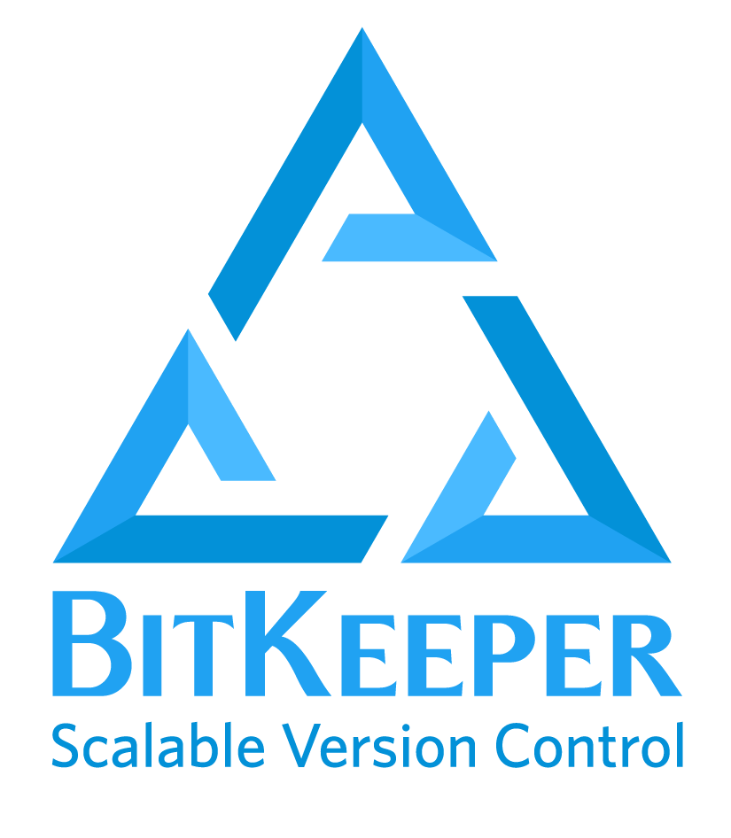
Notes:
Who here has heard of BitKeeper? Who has used it? I have no personal experience with this tool, but, as we'll see, it's an incredibly important version control system for two reasons.
Now, I know I said we were not going to cover commercial version control options, but the history of git cannot be separated from BitKeeper. BitKeeper is probably the most important commercial version control system ever. Almost certainly not the most widely used, but the most important.

Slide 76

Larry McVoy
Wikimedia Commons / Eugene Zelenko
Notes:
There isn't a lot of information available about the history of BitKeeper. Most of what I was able to find comes from their now open-sourced repository. Their repository mentions that Larry McVoy wrote a semi-distributed VCS while working at Sun. That was later turned into Teamware. You can also see the complete history of the project all the way back to when it became self hosting in March 1999.
BitKeeper itself was a product of BitMover, which as far as I can tell, was created solely to create BitKeeper.

Slide 77
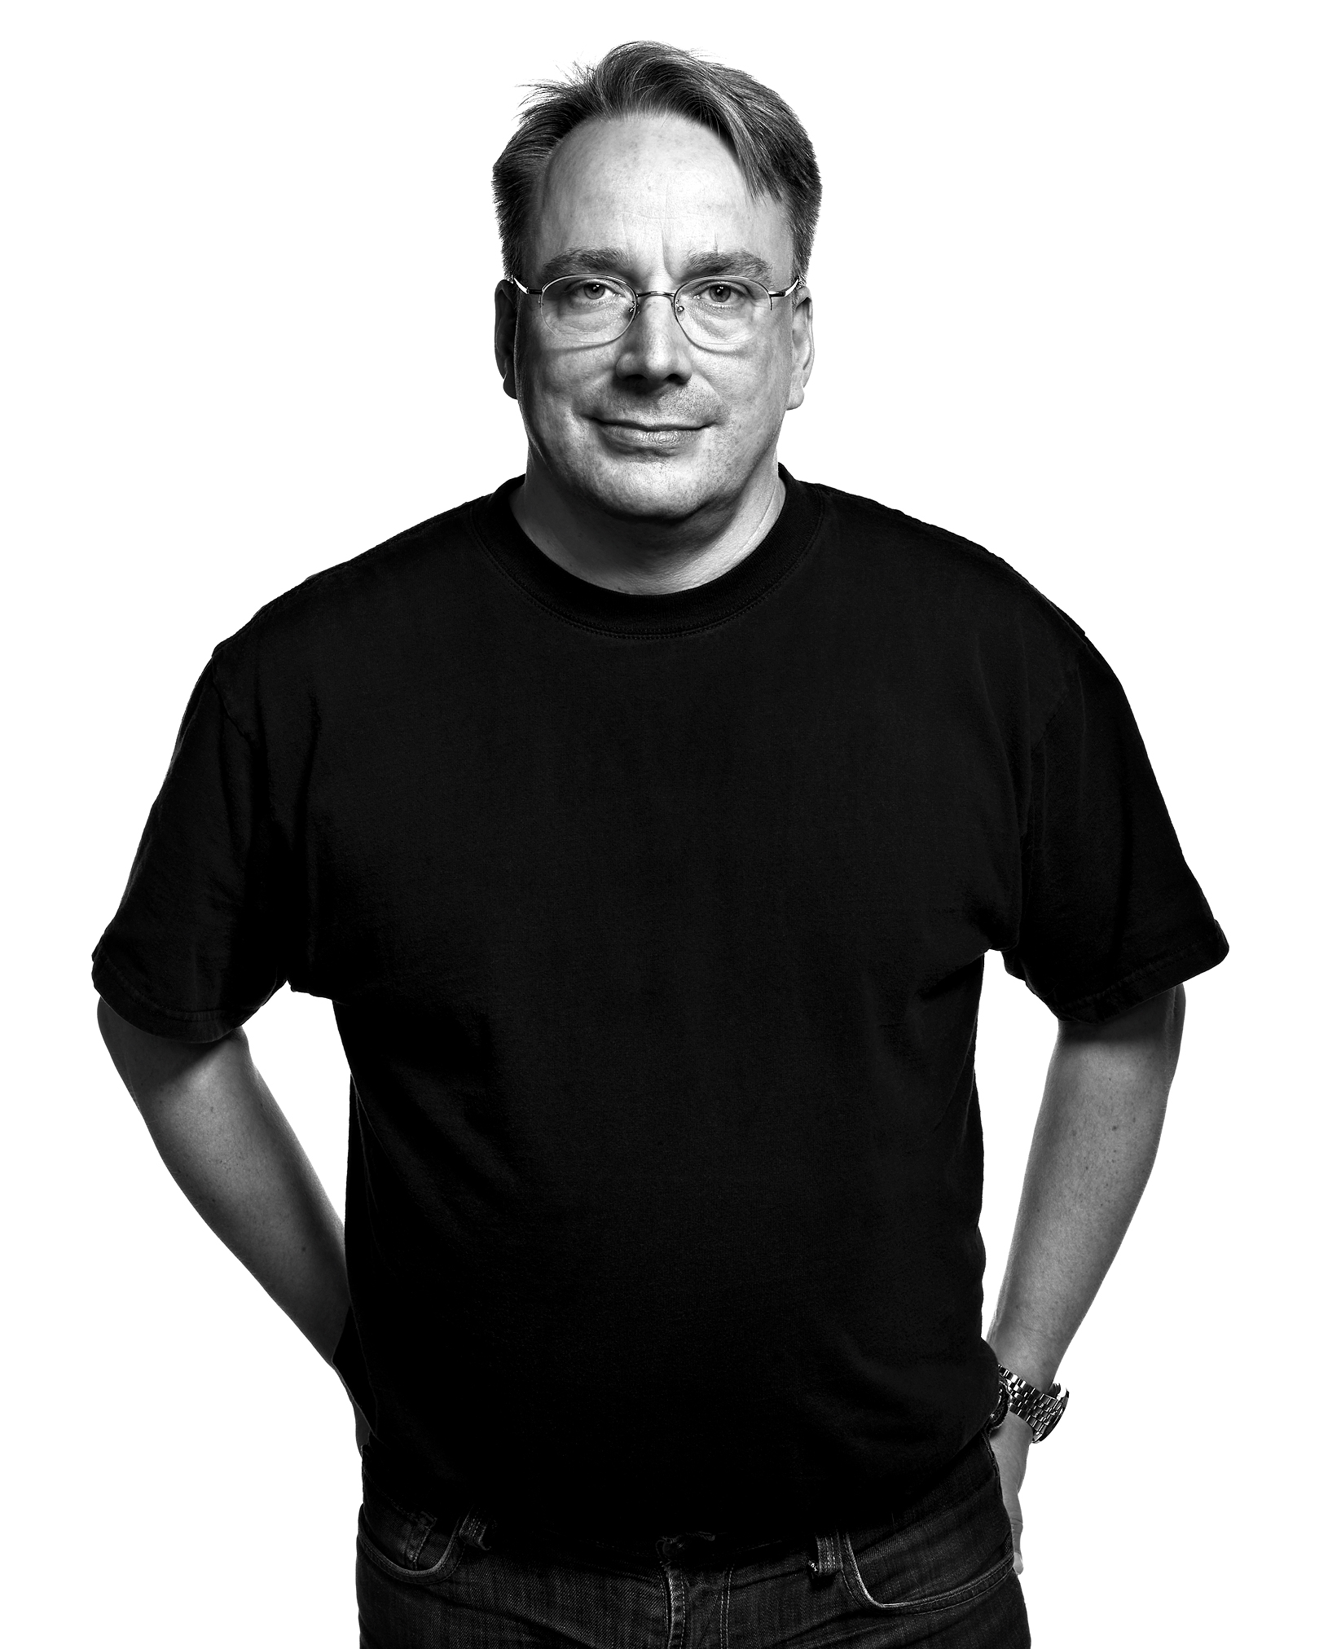
Linus Doesn’t Scale
Faces of Open Source / Peter Adams
Notes:
On Sept. 30 1998 Larry McVoy sent a message to the kernel mailing list outlining a proposal for how to solve the Linus scaling problem. At the time, Linux was experiencing growing pains. Linus was a bottleneck for getting patches merged into the kernel. The proposed solution was a DVCS that would allow others to test and tweak patches in a very transparent manner as they made their way towards Linus through his circle of trust. This DVCS would be developed by his company, BitMover.

Slide 78

http://www.bitmover.com/bitsccs/
Notes:
In that message Larry also linked to a page about BitSCCS, which is fascinating. It's a reimplementation of SCCS that also adds a number of new features. It served as the underpinnings of BitKeeper.
In a harbinger of things to come, there is a licensing section that highlights that it will be free as in beer for free software development, but paid for commercial development. As of October 1, 1998, Larry estimated that he has lost $118,000 from quitting his job to work on this project with the explicit goal of helping Linus.
Let’s step back and appreciate this though. The core of the first 3rd generation version control system was a reimplementation of the very first version control system. That’s amazing.
BitKeeper became self-hosting in March 1999. Early access betas became available in May 1999 and the first public release on May 4, 2000.

Slide 79

Notes:
In 2002, BitKeeper was adopted by the Linux kernel. This decision was highly controversial. Torvalds and other core developers accepted the free license, but other core developers did not. This tension would come to a head in 2005.

Slide 80

Andrew Tridgell
Wikimedia Commons / Singa Kuttty sivasakthi
Notes:
BitKeeper's free software license prevented any attempts at reverse engineering. In April 2005, BitMover announced that it would be revoking this license because Andrew Tridgell (pronunciation?) had started reverse engineering the wire protocol to develop a third-party BitKeeper client. Larry McVoy said this violated the license and a lot of heated arguments ensued, with Torvalds in the middle. Tridgell had also been instrumental in reverse engineering SMB to create Samba, so this was very on brand for him. (He had also co-developed rsync for his PhD dissertation.)

Slide 81


Free Standards Group
Notes:
In another interesting note, Tridgell and Torvalds were both fellows for the Open Source Development Labs (OSDL) at the time. This later merged with the Free Standards Group in January 2007 to become the Linux Foundation.

Slide 82

Notes:
Tridgell argued that he had never bought or owned a BitKeeper license. Thus, he had never agreed to its license and was not bound by it's restrictions around reverse engineering. It was ethical reverse engineering, just like Samba. Tridgell claimed that all he had done was telneted into a BitKeeper server and typed _help_. His goal was to provide features around metadata and comparing past revisions, features that were only available in the commercial version of BitKeeper.
In the end a very angry Torvalds was left to find a replacement for BitKeeper. We'll come back to that. (Foreshadowing!) I really wanted to put up the picture of Torvalds flipping the bird, but I decided that wasn’t appropriate. For those who know what I’m talking about though, just imagine that image goes here.

Slide 83
Licensing Issues
Free vs. Commercial
Notes:
BitKeeper became the first widely used distributed version control system (DVCS). If you're going to pick a VCS to start the 3rd generation of version control. BitKeeper is probably your best bet. This means that BitKeeper had all the strengths of a DVCS compared to it's centralized competitors.
But BitKeeper's licensing was... problematic. It tried to straddle the line between the free and commercial worlds. This kind of setup is fairly common today. BitKeeper compounded that though by adding a clause preventing users of the free version from participating in the development of a competing tool. You couldn't contribute to any other VCS if you used BitKeeper without violating the license. You had to wait another year after your use of BitKeeper ended to start contributing to anything.

Slide 84
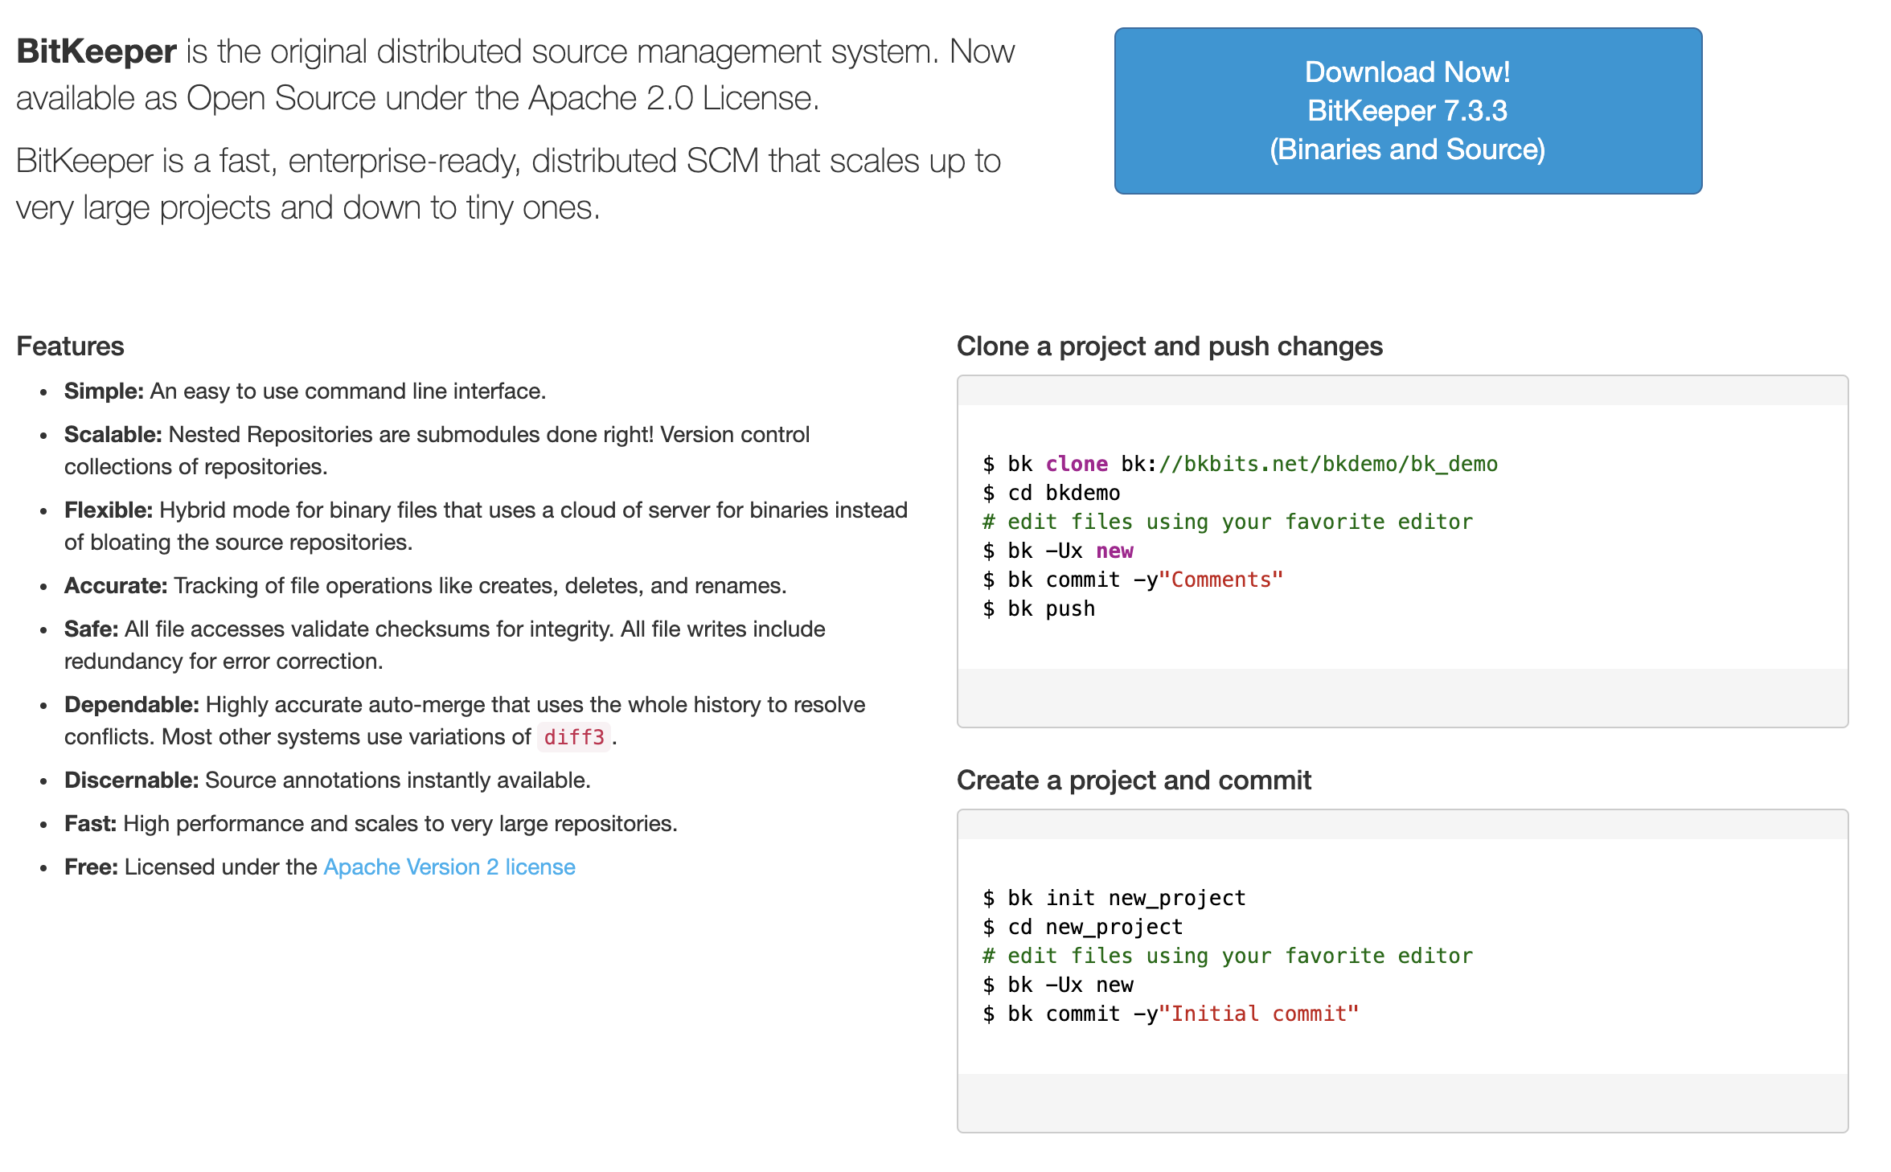
https://www.bitkeeper.org/
Notes:
BitKeeper was open sourced under Apache 2.0 on May 9, 2016 with version 7.2ce (CE = community edition), in what many interpreted as a belated attempt for relevance. Like just about every version control system in the wake of git, by 2016 BitKeeper was mostly a forgotten relic. It was mostly remembered for its role in the creation of git.
The current stable release is 7.3.3 on Dec. 29, 2018. The public repository on bkbits.net has no commits since. It's not clear what the development status of the product is.

Slide 85

https://commons.wikimedia.org/wiki/File:Monotone-logo.png
Notes:
We’re going to go rapid fire here now. The stage has been set. Larry McVoy was rescinded the BitKeeper license for Linux kernel development and Linus Torvalds is trying to figure out what to do. His disdain for CVS is legendary. He views SVN as a bit better, but still flawed in the same fundamental ways that CVS is. He wants a distributed version control system, so he starts evaluating the existing options, which brings us to…
Who here has heard of monotone? What about used it? Personally, I have no experience with it and hadn't even heard of it until starting to do research for this talk.
And this is literally the only version of the project logo that I could find on the internet. That’s the biggest version.
The initial release was on April 6, 2003, but I wasn't able to find much information besides that. The initial creator of monotone was Graydon Hoare. Does anybody know what else Graydon Hoare is associated with?

Slide 86
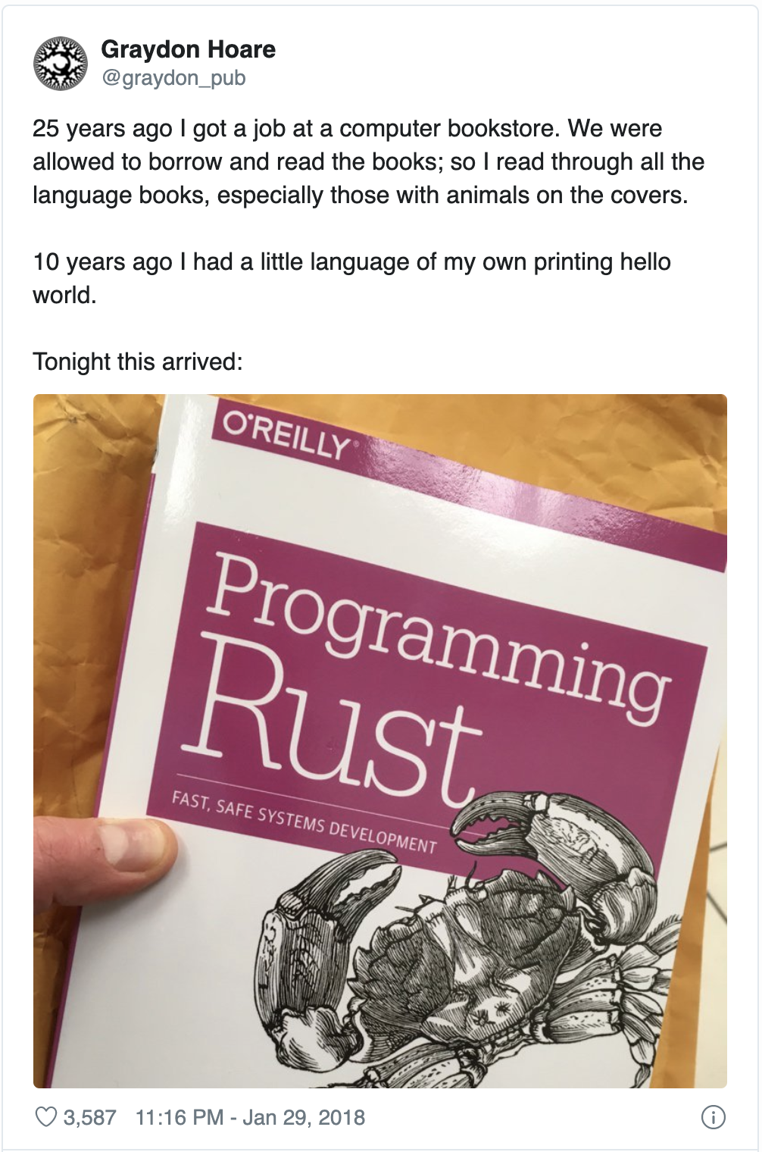
Twitter
Notes:
He's the initial creator of Rust!
And remember that Jim Blandy, one of the creators of Subversion is the author of Programming Rust. It’s kind of amazing how interconnected some of these things get.
It's hard to find much information about the early development of monotone. The mailing list starts on April 9, 2003. Similarly, the IRC logs only go back to Oct. 26, 2005.
The name comes from Graydon's desire to pursue the concept of "monotonically increasing test coverage." The basic idea was to automatically maintain a repository of code that always passes all the tests. Monotone was eclipsed by git though and never got there.

Slide 87
Evaluation for Linux
SHA-1
Performance
Notes:
Monotone uses SHA-1 files to identity objects, much like git. The SHA-1 is actually used for security with a certificate.
Performance. The project placed a higher emphasis on on integrity instead of performance. This was magnfied when Torvald's was looking at monotone as a replacement for BitKeeper. The 0.17 release had just added a lot of sanity checks that severly degraded performance. This is when Torvalds looked at it. Performance was never the best and may never have been good enough for Linux, but the timing was very unfortunate.

Slide 88
Monotone Today
Notes:
Monotone never caught on. It's only real moment in the sun came from Linus Torvalds mentioning that he looked at it before writing git. He discarded it because of the poor performance.
The last release was 1.1 on May 4, 2014. That was over five years ago. Looking through the mailing list, that release seems to have been a last gasp just to package together various patches that that distro packages were accumulating. There have been no commits since, although it's hard to tell because the official source repository seems to be offline.

Slide 89

Notes:
Has anyone here used Darcs? How many here even know what Darcs is? How were you using it? Professionally? Hobby? Just testing it out?
Personally, I used Darcs from 2010 - 2012 while working at a small consulting company.

Slide 90
Darcs
David’s
Advanced
Revision
Control
System
Notes:
David Roundy is creator of Darcs. His little pet project originally stood for David’s Advanced Revision Control System, but he later changed to what he felt was the less embarrassing backronym of Darcs: Advanced Revision Control System.

Slide 91

David Roundy
http://physics.oregonstate.edu/~roundyd/people.html
Notes:
David’s background is a bit different then what you would expect from someone creating a version control system. He received his Ph.D. in physics from U.C. Berkeley in 2001. While doing post-doctoral work, he was also working on a cross-platform online bridge game called aBridge. He was using CVS on SourceForge, but wasn't happy with it. Subversion was really new at the time, but Roundy was interested in the idea of a distributed system, so he started looking into Arch.

Slide 92

https://en.wikipedia.org/wiki/File:GNU_arch_logo.png
Notes:
Quick side note, Arch was GNU's distributed version control system that we won't go into here. The bare minimum is that it was started in 2001 and had petered out by 2008.
It’s definitely at the top of the version control logo competition though. That thing is adorable.

Slide 93
David Roundy
http://physics.oregonstate.edu/~roundyd/people.html
Notes:
Anyways, back to Darcs. Arch didn't really satisfy David either. In June 2002 he got involved in discussions about creating a new patch format for arch, but it became clear that his proposal would never be incorporated. He found the ideas interesting though, started playing around with them, and, behold, Darcs was born. (And since a developer can really only dedicate sufficient time to one side project, aBridge essentially died to give us Darcs.)
The initial version of Darcs was written during the summer of 2002 in C++. However, there was a lot of experimentation as Roundy figured out what exactly he was trying to implement, so by that autumn he had a very solid mass of bugs that was difficult to debug.

Slide 94

(Haskell)
Wikimedia Commons
Notes:
Anybody know what logo this is?
Around that time he had also started looking into Haskell, so... guess what happened next? When you have a side project you should always make it more complicated by re-writing in a language you barely know.
The first public release of darcs was v0.9.3 on April 3, 2003. Windows support was added that summer.
In April 2008, Darcs 2.0 was released. It "introduced a more robust repository format, as well as a new patch semantics called "darcs-2", aimed at minimizing exponential merge issues.” The exponential merge issues were a performance issue that could happen with certain conflicts.

Slide 95
Strengths
Weaknesses
Patch theory
Interactive CLI
Performance
Interactive CLI
Notes:
By far the most interesting part of Darcs is its theory of patches. In Darcs, a repository is a set of patches that are not necessarily ordered with respect to other patches. Darcs automatically calculates whether patches can be reordered and how it should be done. If your patches modify independent parts of the code, then they are not dependent upon each other and can be applied in any order. This makes it easy to merge individual patches. Since Darcs calculates the dependencies between them, it will also tell you what dependent patches need merged as well.
I thought about diving into more theory and examples of this, but I don’t think it’s a good use of your time. If you are interested, then I highly recommend checking out the theory section on the official Darcs site. It has a lot of good examples of what Darcs tries to do and how.
The other big advantage of Darcs is the CLI. Who hear knows the ins and outs of the git CLI? Definitely not me. I always have to reference the docs once I get off my happy path. Darcs on the other hand has a very explicit goal of an easy to use, interactive CLI.
Who here uses _git add -i_? That type of interactive command is the default it darcs. A lot of time and care has been spent to make it feel usable and intuitive to mere mortals.

Slide 96
Darcs Today
Notes:
Today, Darcs is a very niche version control system. It's still actively developed, but at a pretty slow pace. 2.14.2 came out in January 2019 and when I checked on December 17, 2019, there hadn't been a single commit since October 2, 2019.
My understanding is that it is more common in the Haskell community, which makes sense since it's written Haskell. But even the Darcs diehards have mostly accepted that git has become The One True VCS. Even way back in 2011 there was talk in the community about Haskell projects starting to move away from Darcs to git.

Slide 97
Notes:
We’ve finally made it. It’s time to talk about git.
Who here has used git? I expect to see most hands in the air for this one. Now, who is currently using it on a daily basis? Anybody who started using it way back in 2005?
The early history of git is tightly bound to the history of Linux version control. As we already discussed, in 2002 Linus decided to adopt BitKeeper for kernel development. The use of a closed source version control tool remained a point of tension until finally boiling over in April 2005 when Larry McVoy rescinded the free license for open source software over Tridgell's reverse engineering efforts.

Slide 98
BitKeeper Replacement Criteria
A patch should take no more than three seconds to apply.
Take CVS as an example of what not to do; if in doubt, make the exact opposite decision.
Support a distributed, Bitkeeper-like workflow
Include very strong safeguards against corruption, either accidental or malicious.
Notes:
This left Torvalds and the wider Linux development community in a tough place. Torvalds set the following criteria for any system that would replace BitKeeper.
Torvalds's disdain for CVS was widely known. He had even gone so far as to say that kernel development would revert back to using no version control at all instead of using CVS. He spent a bit of time evaluating monotone and darcs, but ended up rejecting both for performance reasons. Monotone though provided inspiration in its use of hashes.

Slide 99
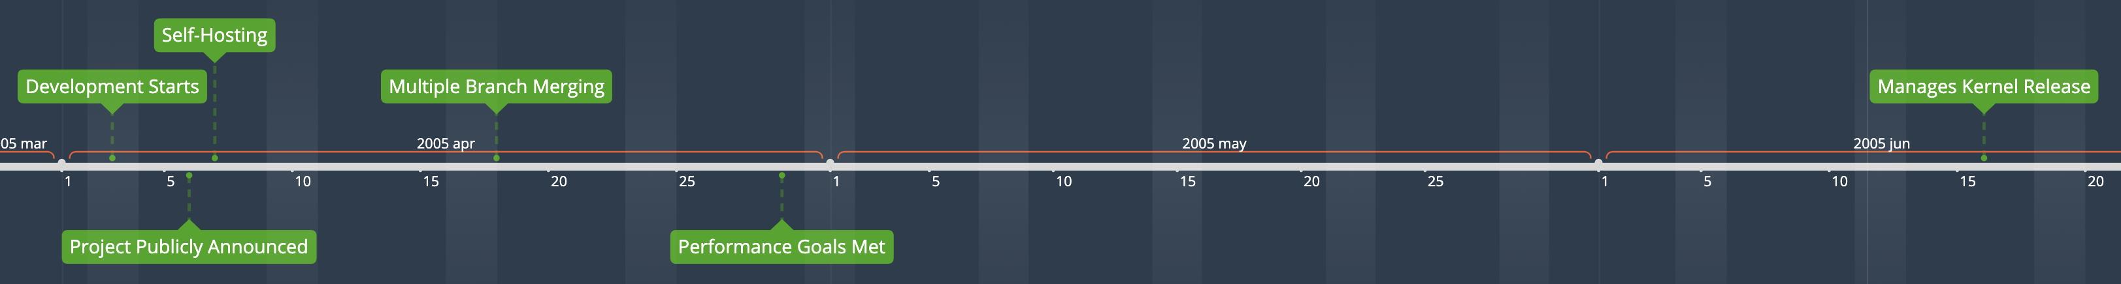
Git Development Timeline
Notes:
Following the release of kernel v2.6.12-rc2, Torvalds was able to start dedicating all of his time to the first version of git. Development was rapid.
* April 3, 2005: Development begins
* April 6, 2005: Torvalds announces the project
* April 7, 2005: Git becomes self-hosting. The README also contains multiple meanings of the name, although Linus seems to have decided that the true origin is the British slang "git", which means "a silly, incompetent, stupid, annoying, or childish person". He claims that he's now been arrogant enough to name two projects after himself, Linux and git.
* April 18, 2005: First merge of multiple branches
* April 29, 2005: Performance goals met. Recorded 6.7 patches per second to the Linux kernel tree
* June 16, 2005: Git managed the kernel 2.6.12 release.

Slide 100

Junio Hamano
Faces of Open Source / Peter Adams
Notes:
Torvalds turned over maintenance to Junio Hamano on July 26, 2005. Hamano had been a major contributor.
1.0 was released on December 21, 2005. Hamano remains the project maintainer to this day.

Slide 101

Wikimedia Commons / Gael Mace
Notes:
In the early days, git was notorious for being difficult to use. Linus had developed a system designed specificially for his workflow around merging patches into the Linux kernel. It's taken many years of work to make the project more usable. In a 2007 talk at Google, Torvalds mentioned that he thought that git was mostly usable for other projects at that point.

Slide 102
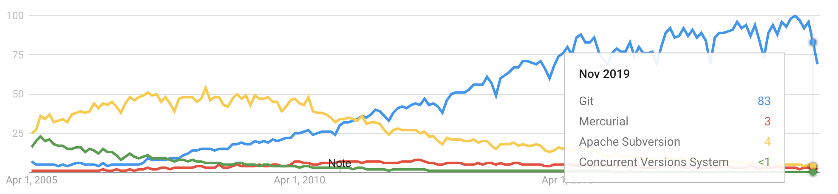
Adoption
Notes:
Git had a huge advantage compared to any other VCS in history. The highly visible conflict over BitKeeper, on the most highly visible open source project in the world, with the most famous open source developer in the world as a central figure gave it an enormous amount of visibility. Git was then able to capitalize on that visibility by rapidly creating an initial version and using it to manage a release of the Linux kernel.
Atlassian put together a nice infograph for git's ten year anniversary. It unfortunately doesn't link to exact sources, but it claims that in git installations on Debian Linux skyrocketed in January 2010. By January 2011, git installations on Debian Linux had surpassed Bzr, CVS, Mercurial, SVN, and Darcs combined. Obviously Debian Linux users aren't a necessarily representative group, but I think it's safe to say that git was becoming dominant by this time. I remember joining a company that was using Darcs around this time and one of my questions for them in the interview was why not git.
In October 2011, Bitbucket added git support. Up until then it only supporter Mercurial. In retrospect, the writing was on the wall at this point.

Slide 103
Eclipse Community Survey (2009 – 2014)
Notes:
This graph shows Git adoption vs. SVN from 2009 – 2014 in the Eclipse Community Survey
By 2018 the Stack Overflow community survey showed that almost 90% of 74,000 developers surveyed preferred to use git. The results were so lopsided that the 2019 survey dropped the question completely.

Slide 104
Influences
Notes:
This isn't a technical talk, so I'm not going to dive into any details of git internals, but I think that it is very important to point out how unique git is compared to what came before it and why.

Slide 105
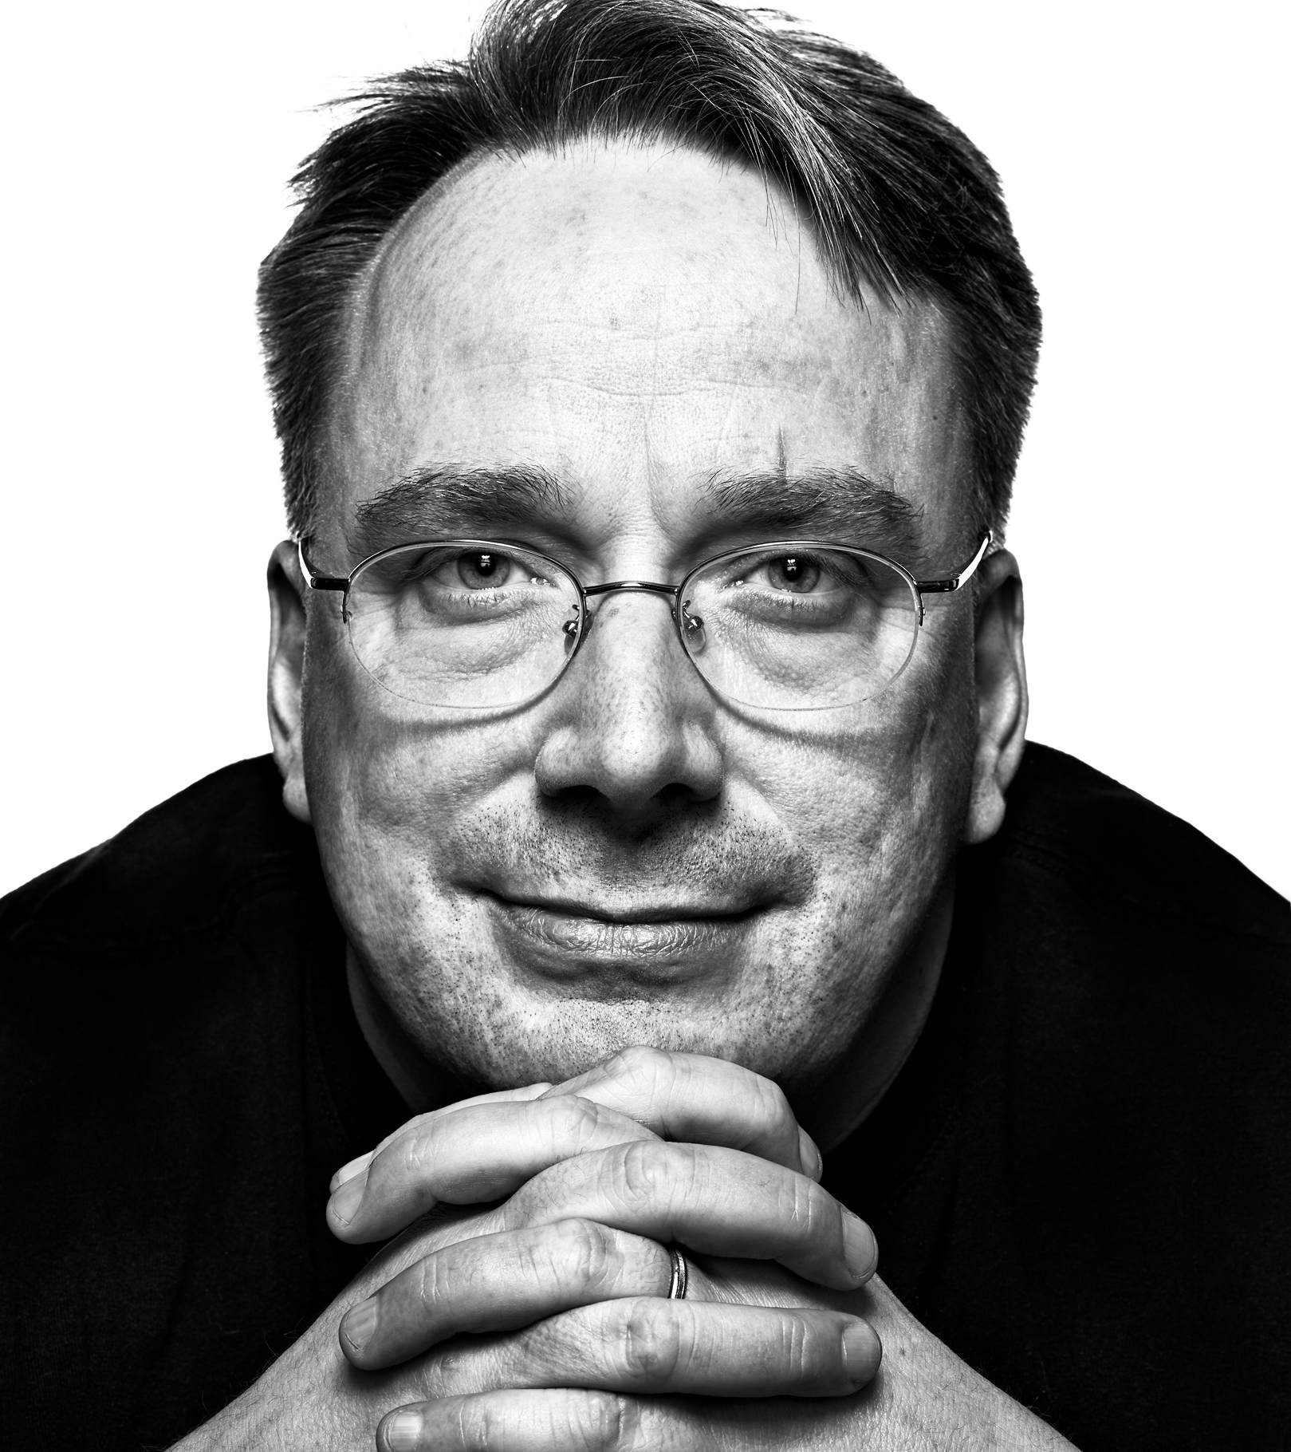
Linus Torvalds
Experience managing Linux
File system performance
Urgency
Faces of Open Source / Peter Adams
Notes:
There are three primary constraints/influences that had a large effect on the initial design
* Torvalds's experience maintaining a large distributed development project.
* Torvalds's intimate knowledge of file system performance. This is what he knew, so building a VCS around the file system instead of a DB was very natural for him.
* The urgent needs to have a working project in short order. Torvalds gave himself a two week deadline for the initial version of git.

Slide 106
When I did git, one of the things that actually helped me was that I was consciously trying to not do a BK clone. I wanted to do the same things that BK did, but I very much did not want to do them the way BK did them. I respect Larry too much, and I didn't want there to be any question about git being just a "clone".
So a lot of the git design ended up very much trying to avoid old designs on purpose, and I think that really helped. The fact that I didn't have a background in SCM's, and that I thought all the weaves etc were confusing, meant that I instead went for a radically different way of doing things.
And I'm 100% convinced that "radically different" was the right thing to do. That was what allowed git to really soar. A lot of the good things in git come exactly from the fact that git does not do things like most traditional SCM's do. But BK should still get a lot of credit, because it was what taught me (and a lot of other people) what being "distributed" really meant.
- Linus Torvalds (Git mailing list 2006-10-19)
Notes:
I’ve tried to avoid having walls of text on slides, but I’ve included this one. You don’t have to read it all now, but this is a post from Torvalds in October 2006. I would highly encourage you to check out the entire post if you can. I’ll make the slides available and you can check it out yourself. The fact that almost the entire history of git is available in both git and mailing list discussions is really unique. It’s a stark contrast to how difficult it was to find information about the early history of other version control systems.

Slide 107
And finally, Monotone for the "everything is an object named by its SHA1" model, which to some degree is perhaps the central - or at least the most obvious - part of git. It largely was designed really just to be the "backing store" for the "cache", and to not be _that_ important. That also explains why I didn't worry too much about disk usage etc initially: the object store wasn't even the most important part, and I envisioned just moving old objects that weren't needed into some "backup storage" kind of thing.
- Linus Torvalds (Git mailing list 2006-05-05)
Notes:
The biggest contribution from monotone is the idea that every object has a corresponding hash. Torvalds was already planning on using hashes for the history, but monotone took it further. Every object had a hash. This became a central part of git as well.

Slide 108
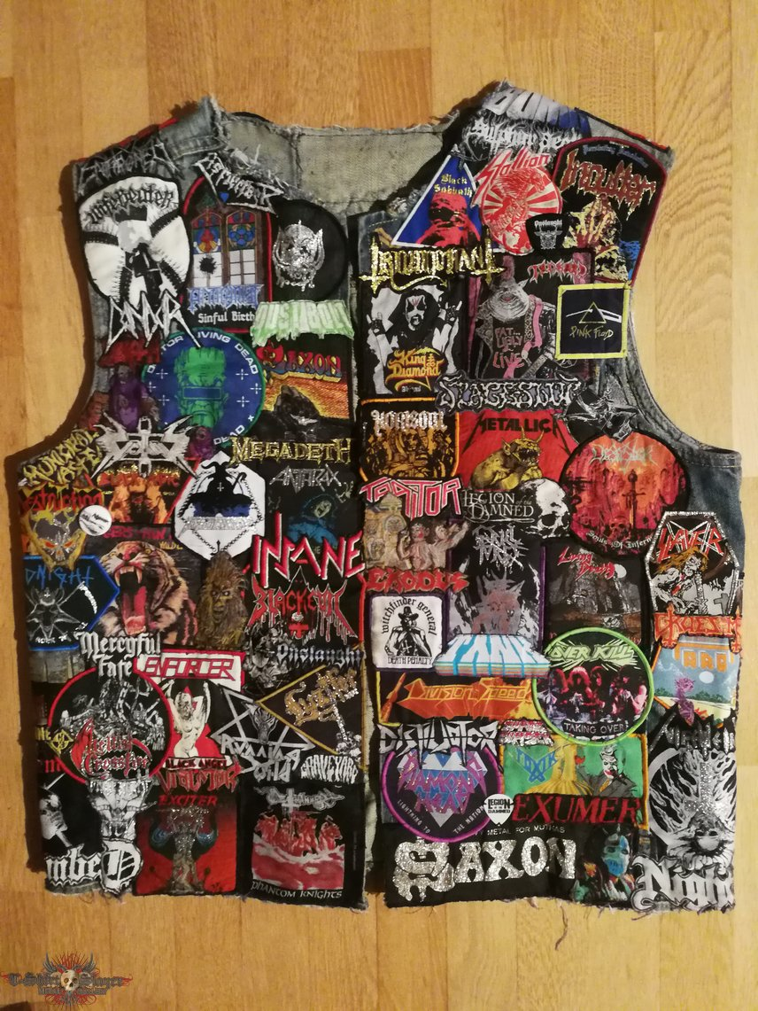
One of the suggestions that I tried to push as an acceptable middle ground was to make a "generic" BK repository export format, so that people who didn't want to use BK could still get all the information, and not in a broken format like CVS (yes, CVS makes sense as an interchange format, since _everybody_ speaks CVS, but it's a horrible, horrible, horrible format from any technical standpoint).
My example export format was really a strange mixture of patches with parenthood information, where the history information was described with hashes (MD5 rather than SHA1, but that was just an implementation thing, and mostly because BK used MD5 sums). Not something really useful as a real SCM, but it wasn't designed for that - it was just meant to be a useful and unambiguous interoperability format.
- Linus Torvalds (Git mailing list 2006-05-05)
tshirtslayer.com / Blade of Tokyo
Notes:
While trying to come up with a compromise between Tridgell and McVoy, Torvalds had proposed a generic export format from BitKeeper. The format was a series of patches with parenthood information. (See https://marc.info/?l=git&m=114685143200012)
Whe no compromise could be reached and Torvalds was searching for a replacement for BitKeeper, this idea was already in his head. If nothing else could be found, he would just go back to lists of patches rather than use CVS.
He eventually extended the series of patches idea to include a "cache" since rebuilding the current state from the beginning was expensive. Conceptually this became the git "index" file and working tree.

Slide 109
Git Today

Slide 110

(It won)
Wikimedia Comons / Elegant Themes
Notes:
Who here is currently working on a project that does not use git for version control? What are you using and why?

Slide 111

Notes:
Git wasn't the only version control system to emerge from the ashes of the BitKeeper fallout. There was also Mercurial.
Who here has used Mercurial? Now, who is currently using it on a daily basis? Who used to? Anybody who started using it way back in 2005?

Slide 112
to initially be as simple (and thereby hackable) as possible
to be as scalable as possible
to be memory, disk, and bandwidth efficient
to be able to do "clone/branch and pull/sync" style development
- Matt Mackall (Kernel mailing list 2005-04-20)
Initial Goals
Notes:
The early history of Mercurial is tightly linked to BitKeeper and git.
Matt Mackall first announced Mercurial on April 19, 2005, thirteen days after Torvalds announced git. His initial goals were (https://lkml.org/lkml/2005/4/20/45)
- to initially be as simple (and thereby hackable) as possible
- to be as scalable as possible
- to be memory, disk, and bandwidth efficient
- to be able to do "clone/branch and pull/sync" style development

Slide 113
Git vs. Mercurial
Notes:
The comparisons to git are inevitable. With regards to performance, git has generally always been faster for most operations, but Mercurial is close behind it. Both of them generally blow away any other DVCS.
Mercurial is written mostly in Python, with some sections written in C/C++ for performance reasons. Because of the choice to use Python, Mercurial was cross-platform from day one. It took quite some time for git to become usable across platforms, especially Windows.
Mercurial prioritized a very usable CLI from day one. This is a big contrast to git, which for years had a reputation for being unusable by mere mortals.
The trade off was that Mercurial lacked many features that git had. For example, Mercurial did not initially support branches. The preferred workflow was to just create another clone of the repo.
The Mercurial team also argued against operations that allowed users to change history, such as rebase. Their philosophy was that that a project's history should be complete and fixed.
Similar to git, Mercurial also took design inspiration from monotone in it's use of hashes.

Slide 114
Mercurial Today

Slide 115
Notes:
Matt Mackall stepped down as project lead in late 2016. Today he works at Facebook, which uses Mercurial. Mozilla is also a notable user of Mercurial.
Facebook is also working on a Mercurial source control server written in Rust called Mononoke.

Slide 116
Notes:
Sadly, today Mercurial is fading as we move ever close to a git monoculture. Bitbucket was originally GitHub, but for Mercurial. Even they have given in though, announcing that Mercurial support will be deprecated in February 2020 and removed on June 1, 2020. Their announcement noted that less than 1% of new repositories were using Mercurial.
The 2018 Stack Overflow Developer Survey showed that almost 90% of developers use git, but only 3% use Mercurial.
It is still under active development though. Version 5.2 was released on Nov. 5, 2019.
I think there definitely is an alternate reality where Mercurial won, but all the factors that have led to such wide adoption of git all worked against Mercurial.

Slide 117

What Comes Next?
David Revoy / Blender Foundation
Notes:
In 1972 we got the first version control system in SCCS. In 1985 we got the first iteration of CVS, kicking off the second generation of version control systems. Then, in 2005 we got git, which kicked the third generation into high gear, bringing distributed version control systems to the mainstream. But 2005 was a long time ago now. Is there anything else on the horizon that could replace git?
In just about every other area of developer tooling there are new options created every year. Sadly, after the explosion in DVCS's in the mid-2000s, there isn't much to talk about. Let's look at a couple though.

Slide 118

Pijul
Wikimedia Commons / Hans Hillewaert
Notes:
Pijul can be thought of as a newer version of Darcs that attempts to fix its performance issues. It is written in Rust and has a slightly updated version of Darcs's patch theory.
I haven't used Pijul myself, but I would be excited to try it on a collaborative project. I liked Darcs. A version with better performance and other improvements sounds like something really cool to try. Easier to use cherry picking sounds great too.
Pijul is still considered beta quality, so use at your own risk.
Pijul is the mexican name of Crotophaga sulcirostris, a bird known to do collaborative nest building.

Slide 119

Notes:
I’m really scratching the bottom of the barrel trying to find something interesting in our git-dominated world.
Plastic is a commercial tool that was first released in 2006. It has a couple of differentiating features.
* Focus on the game industry. This wasn't the original focus, but a shift as git continued to eat the world. One of git's weaknesses is binary assets, so the games industry is one area where git has not achieved widespread adoption. Focusing on a niche is one way that a new VCS could gain a foothold.
* Language awareness allows for history of specific methods/functions instead of just lines. This seems really cool and something I would love to play with.

Slide 120











Why?
Notes:
Why aren’t there more new version control systems coming to supplant git?
GitHub, not git, is the primary reason that no viable replacement for git is on the horizon. Previous generations of version control didn't have to deal with such a strong network effect when replacing the old. Everything works with GitHub. All new open source projects are hosted there by default. An entire DevOps industry has sprung up around it. Realistically, any new version control system would have to be adopted by GitHub to gain significant traction.
Git was so dominant in the Stack Overflow Developer Survey that they don't even ask the question anymore. It had almost 90% adoption in 2018, so they didn't even ask in 2019. We obviously don't have numbers for the entire history of version control, but I feel confident in saying that no other version control system has ever had such numbers. The market was fragmented across many open source and commercial options before.
Pijul is the only new VCS I could find with any buzz around it and even that is minimal. I can't decide if this is a depressing note to end on or not, but that's the current state.

Slide 121

Brian Meeker
@CuriousCurmudge
https://github.com/CuriousCurmudgeon/history_of_vcs
Notes:
So, that was fifty years of history in what I'm hoping was approximately fifty minutes.
I would like to thank all of you for getting up early and coming to his session. If you have any questions or want to chat, feel free to come on up. I'll also be at the InfernoRed Technology booth after this session, so feel free to stop by there to chat. Enjoy the rest of your conference!

